Slide 1
Anjuman College of Engineering & Technology
Engineering Graphics -I
Unit-I
Prof. Ravindra R Paliwal
Department of Mechanical Engineering

Slide 2
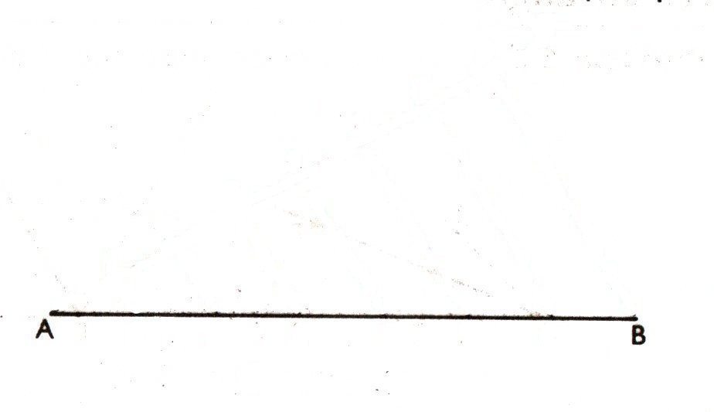
Divide a line in n equal segments.

Slide 3
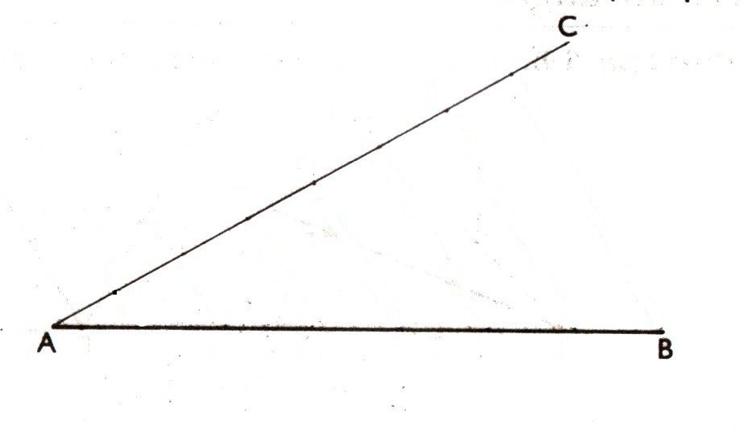
Divide a line in n equal segments.

Slide 4
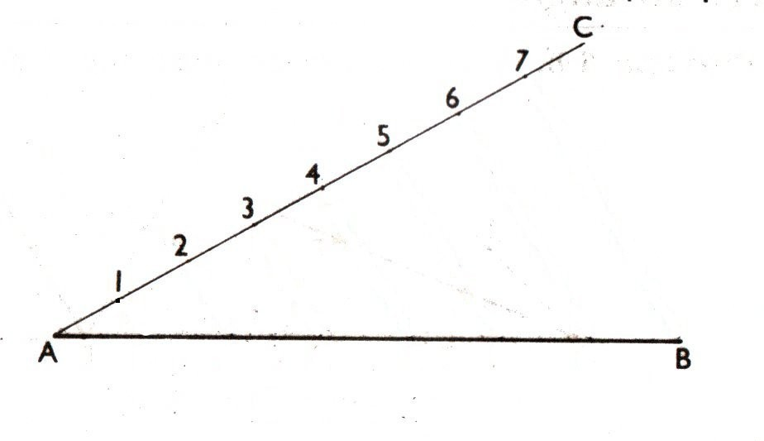
Divide a line in n equal segments.

Slide 5
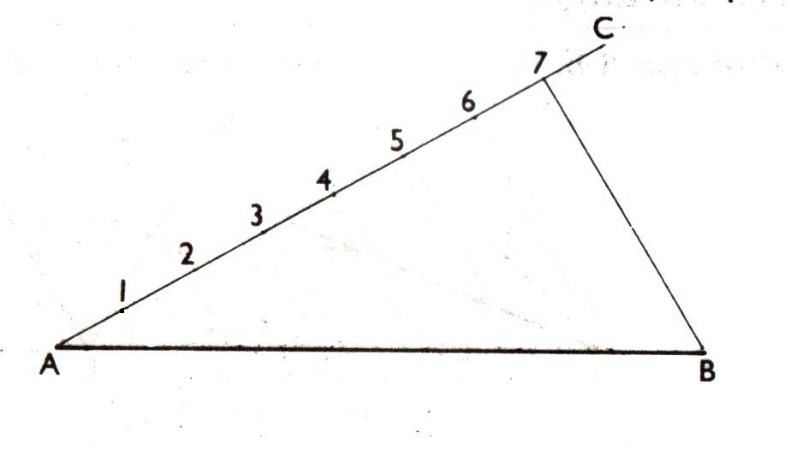
Divide a line in n equal segments.

Slide 6
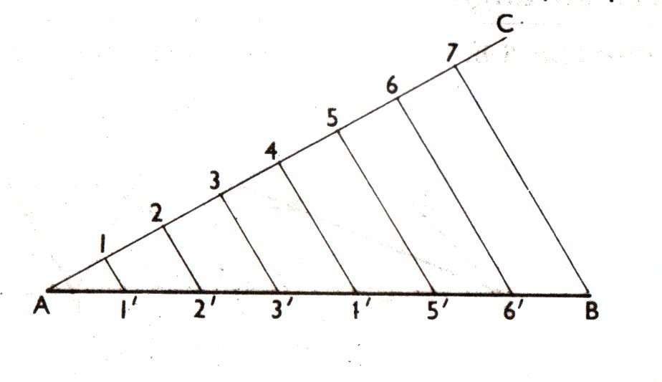
Divide a line in n equal segments.

Slide 7
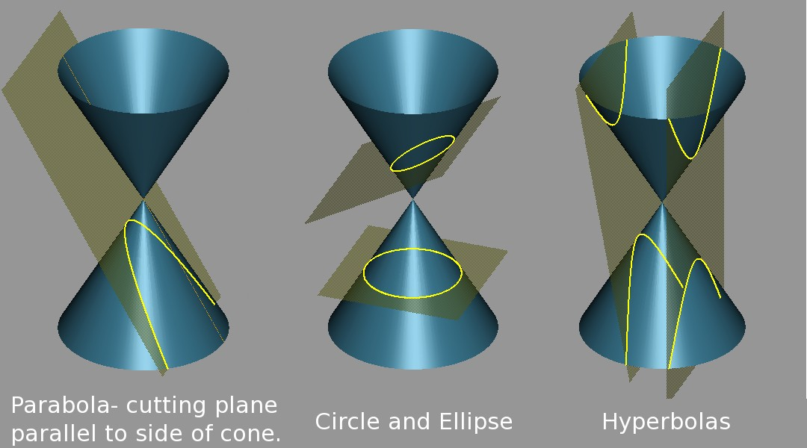
Conic Sections
distance of the point from the focus
Eccentricity =
distance of the point from directrix
e < 1 ⇒ Ellipse, e = 1 ⇒ Parabola and e > 1 ⇒ Hyperbola.

Slide 8
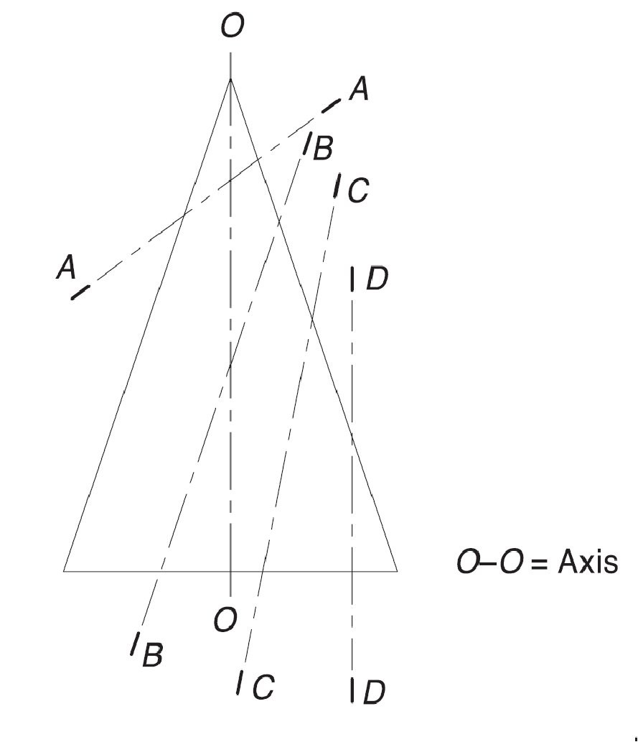
Conic Sections
1
An ellipse ⇒ Section plane
AA, inclined to the axis cuts all the generators of the cone.
2
A parabola ⇒ Section plane
BB, parallel to one of the generators cuts the cone.
3
A hyperbola ⇒ Section
plane CC, inclined to the axis cuts the cone on one side of the axis.
4
A rectangular hyperbola ⇒
Section plane DD, parallel to the axis cuts the cone.

Slide 9
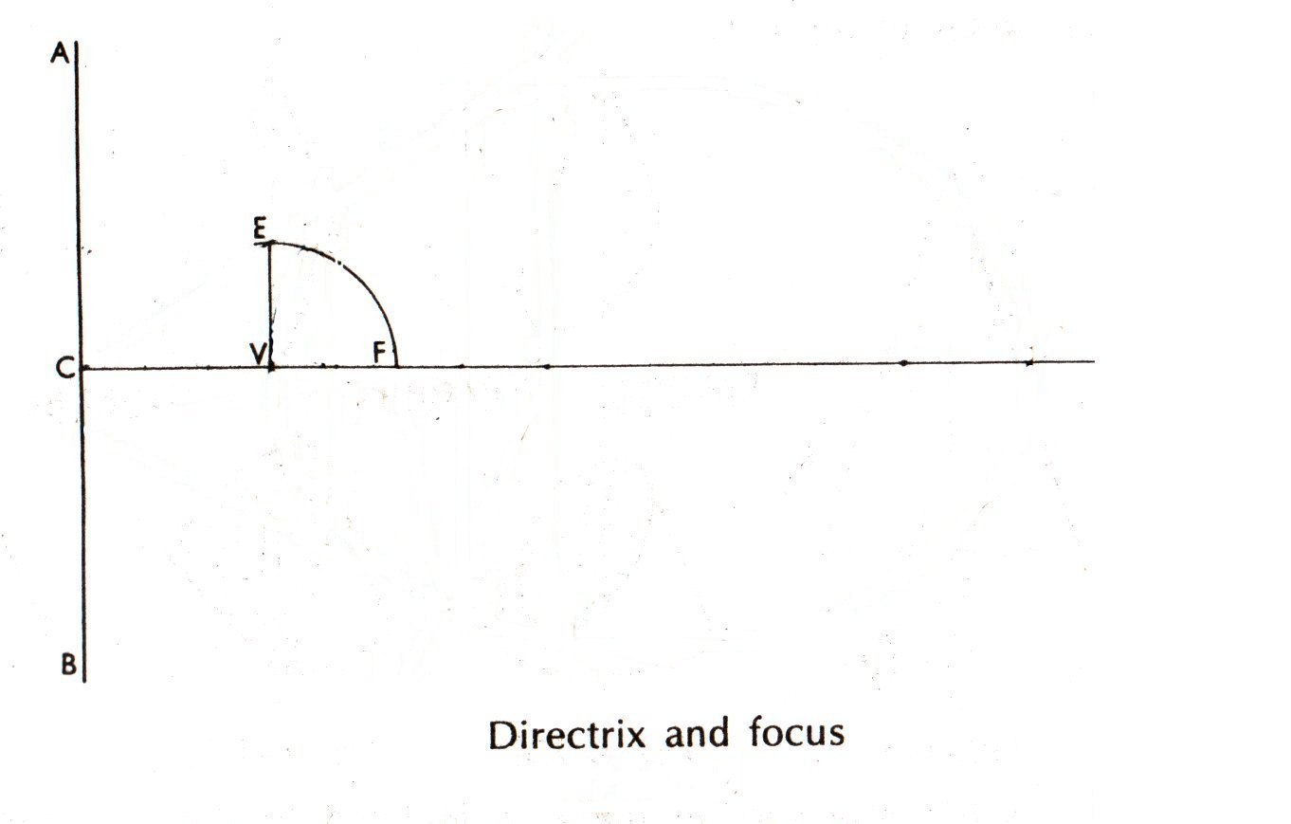
Ellipse by Directrix and Focus
e = 2/3 and focus distance from directrix is known.
1
Divide CF in five equal
segments. Draw VE ⊥ CF
and VF = VE.

Slide 10
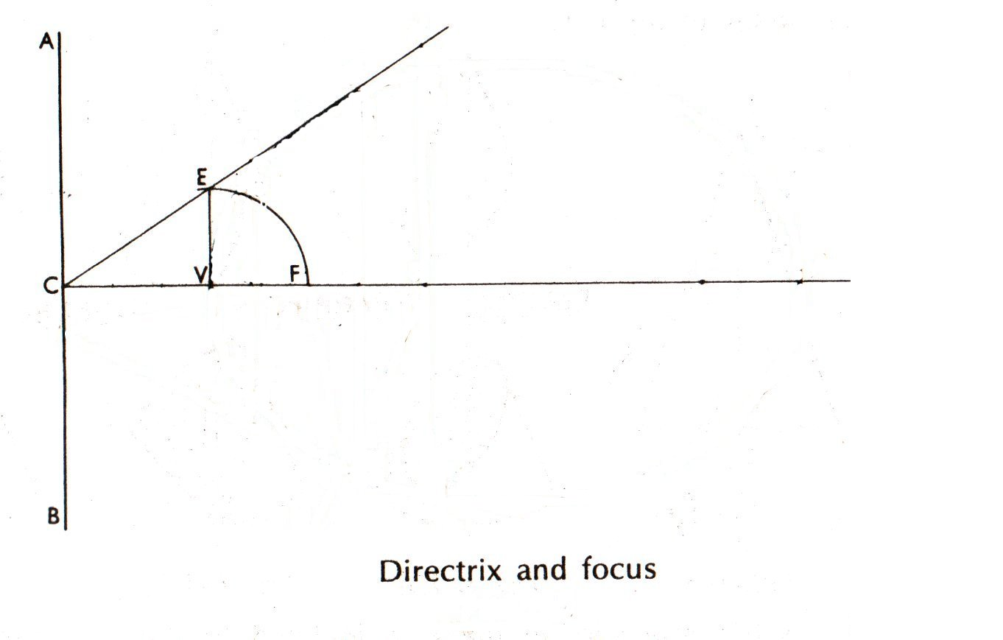
Ellipse by Directrix and Focus
e = 2/3 and focus distance from directrix is known.
1
Divide CF in five equal
segments. Draw VE ⊥ CF
and VF = VE.
2
Extend CE to cover the
horizontal span of the ellipse.

Slide 11
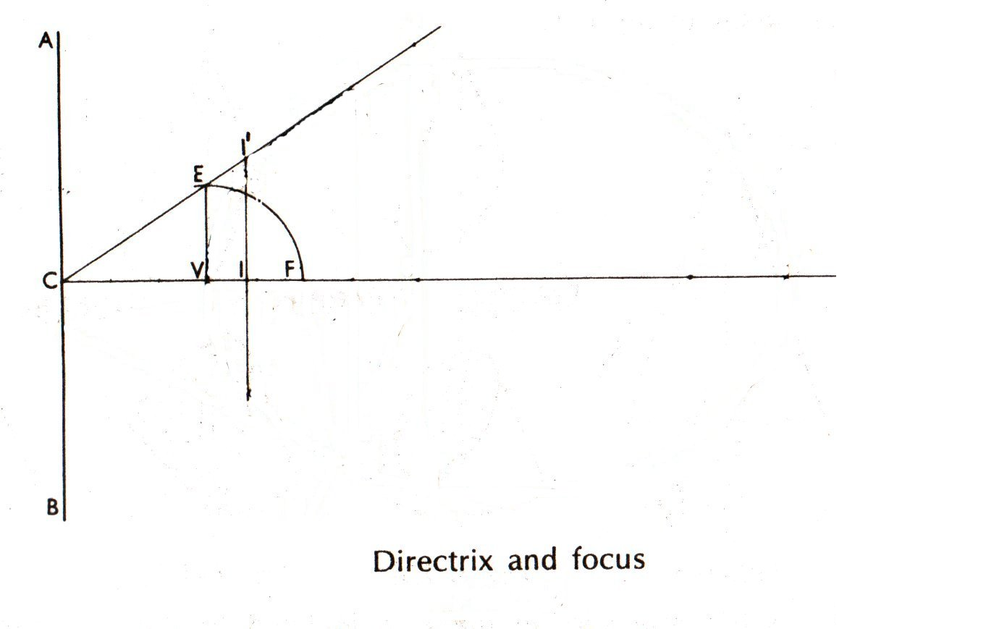
Ellipse by Directrix and Focus
e = 2/3 and focus distance from directrix is known.
1
Divide CF in five equal
segments. Draw VE ⊥ CF
and VF = VE.
2
Extend CE to cover the
horizontal span of the ellipse.
3
Draw a vertical at 1.

Slide 12
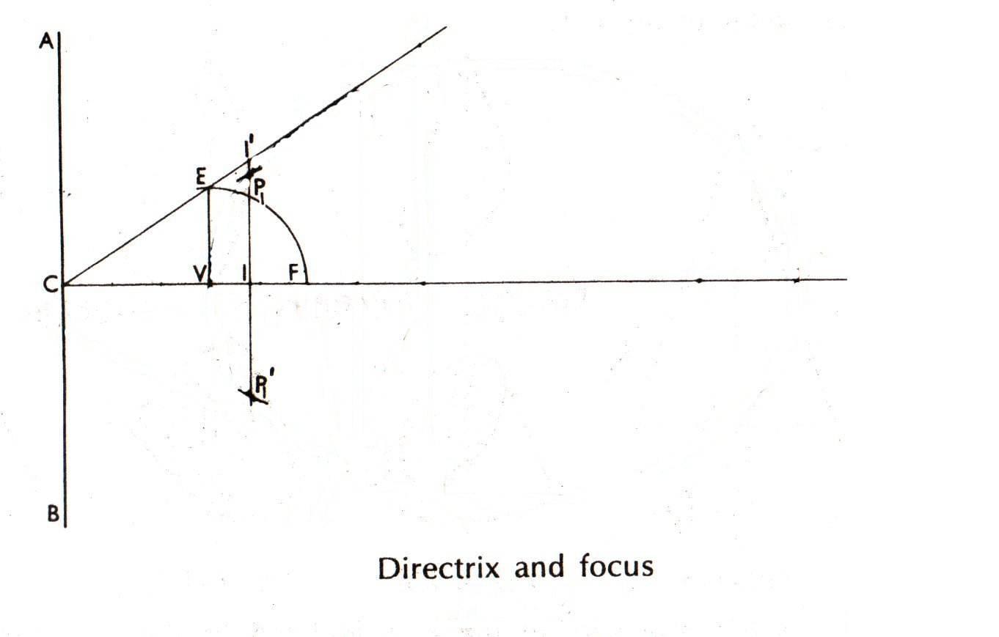
Ellipse by Directrix and Focus
e = 2/3 and focus distance from directrix is known.
1
Divide CF in five equal
segments. Draw VE ⊥ CF
and VF = VE.
2
Extend CE to cover the
horizontal span of the ellipse.
3
Draw a vertical at 1.
4
Use the compass to measure
11‘ and mark P1 and P ‘
1
from F.

Slide 13
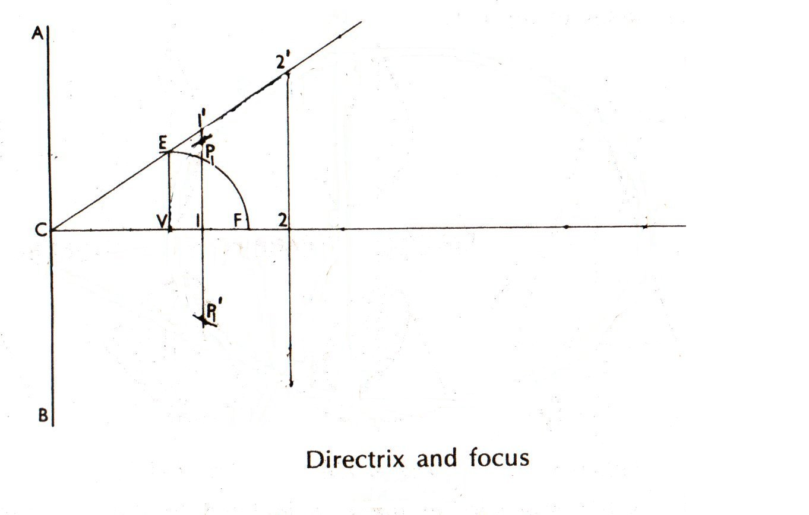
Ellipse by Directrix and Focus
e = 2/3 and focus distance from directrix is known.
1
Divide CF in five equal
segments. Draw VE ⊥ CF
and VF = VE.
2
Extend CE to cover the
horizontal span of the ellipse.
3
Draw a vertical at 1.
4
Use the compass to measure
11‘ and mark P1 and P ‘
1
from F.
Any point, P2 or P ⁰ , is C2 distance apart from the directrix and FP2
2
or FP ⁰ apart from the focus.
2

Slide 14
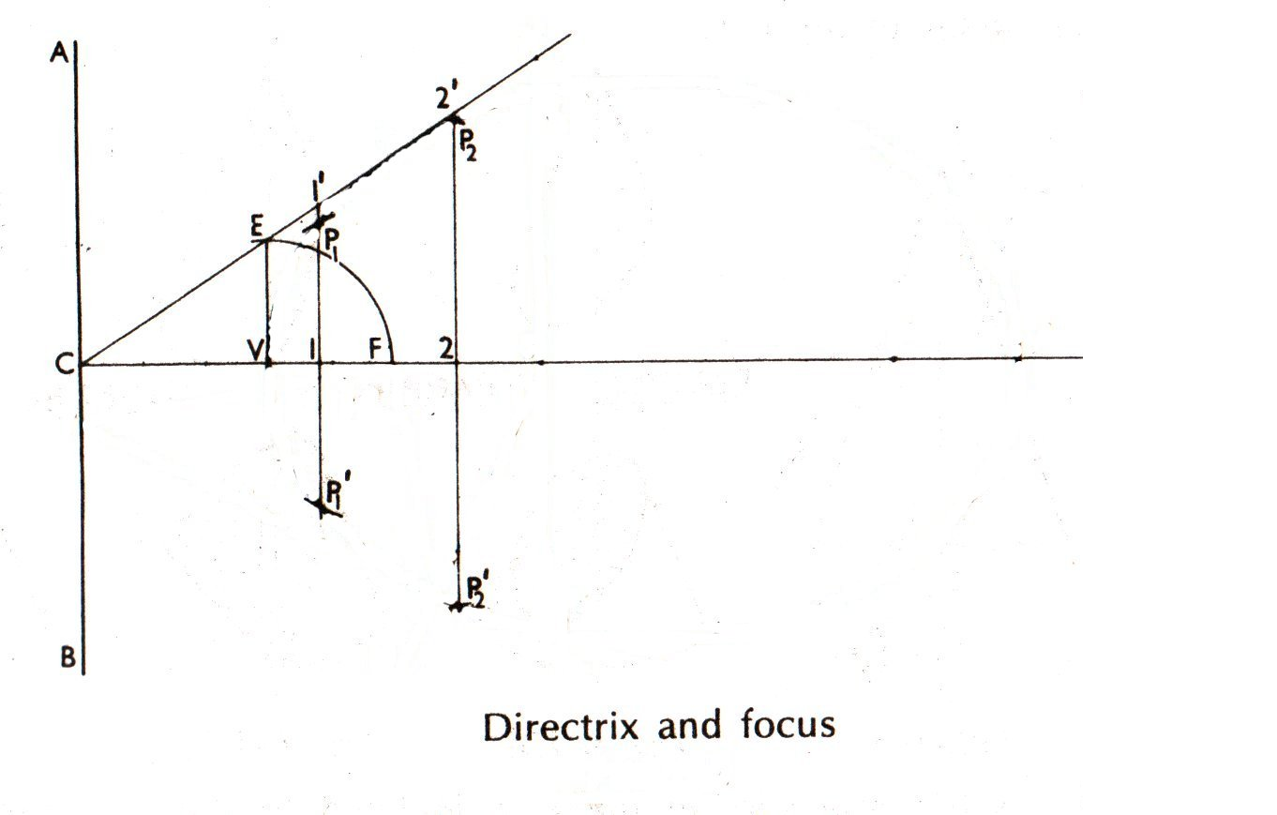
Ellipse by Directrix and Focus
e = 2/3 and focus distance from directrix is known.
1
Divide CF in five equal
segments. Draw VE ⊥ CF
and VF = VE.
2
Extend CE to cover the
horizontal span of the ellipse.
3
Draw a vertical at 1.
4
Use the compass to measure
11‘ and mark P1 and P ‘
1
from F.
Any point, P2 or P ⁰ , is C2 distance apart from the directrix and FP2
2
or FP ⁰ apart from the focus.
2

Slide 15
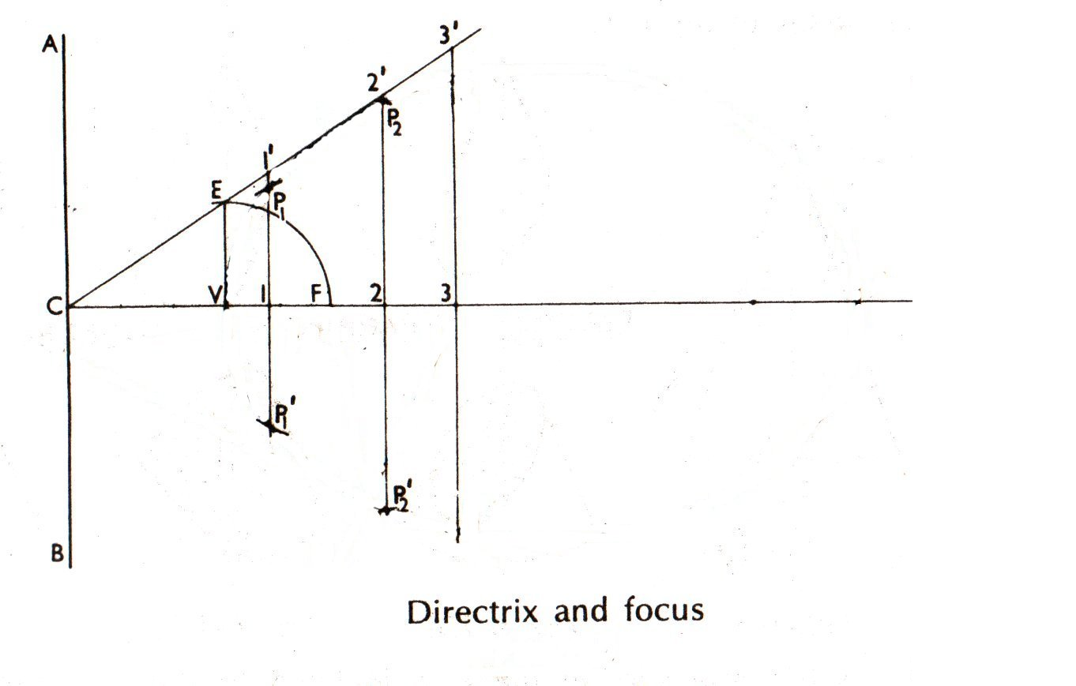
Ellipse by Directrix and Focus
e = 2/3 and focus distance from directrix is known.
1
Divide CF in five equal
segments. Draw VE ⊥ CF
and VF = VE.
2
Extend CE to cover the
horizontal span of the ellipse.
3
Draw a vertical at 1.
4
Use the compass to measure
11‘ and mark P1 and P ‘
1
from F.
Any point, P2 or P ⁰ , is C2 distance apart from the directrix and FP2
2
or FP ⁰ apart from the focus.
2

Slide 16
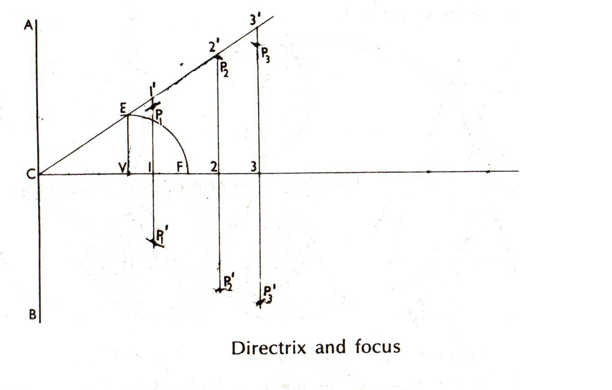
Ellipse by Directrix and Focus
e = 2/3 and focus distance from directrix is known.
1
Divide CF in five equal
segments. Draw VE ⊥ CF
and VF = VE.
2
Extend CE to cover the
horizontal span of the ellipse.
3
Draw a vertical at 1.
4
Use the compass to measure
11‘ and mark P1 and P ‘
1
from F.
Any point, P2 or P ⁰ , is C2 distance apart from the directrix and FP2
2
or FP ⁰ apart from the focus.
2

Slide 17
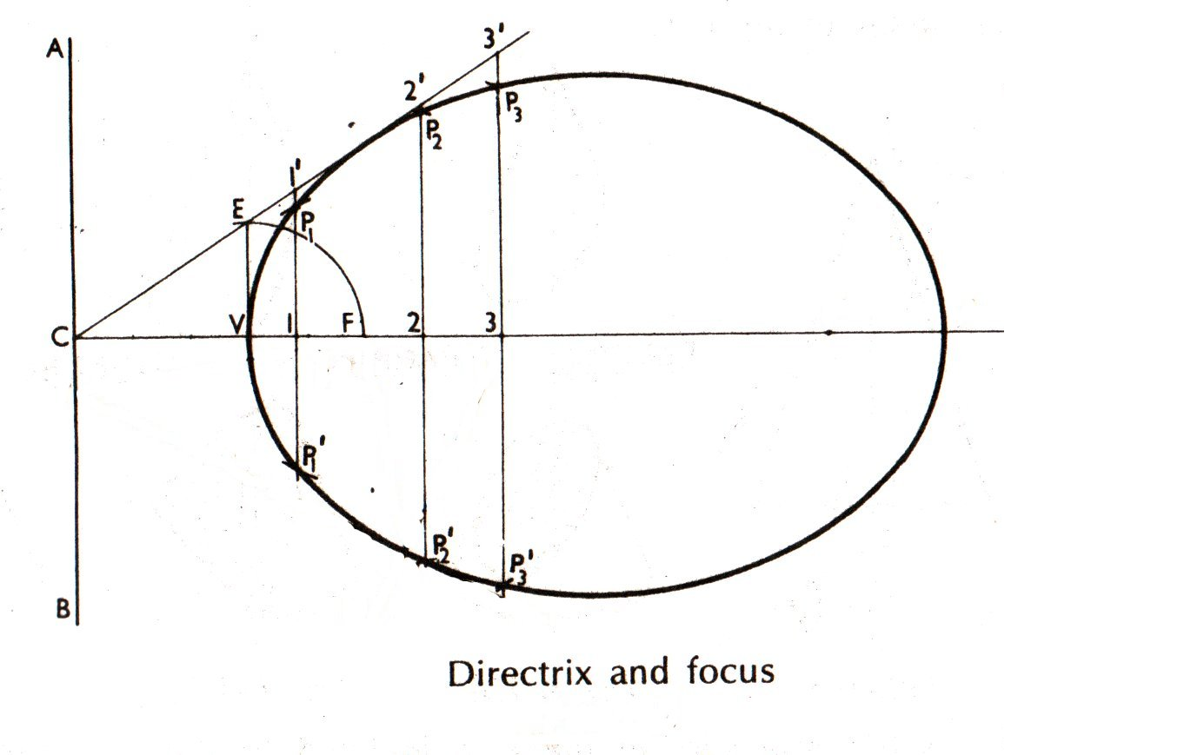
Ellipse by Directrix and Focus
e = 2/3 and focus distance from directrix is known.
1
Divide CF in five equal
segments. Draw VE ⊥ CF
and VF = VE.
2
Extend CE to cover the
horizontal span of the ellipse.
3
Draw a vertical at 1.
4
Use the compass to measure
11‘ and mark P1 and P ‘
1
from F.
Any point, P2 or P ⁰ , is C2 distance apart from the directrix and FP2
2
or FP ⁰ apart from the focus.
2

Slide 18
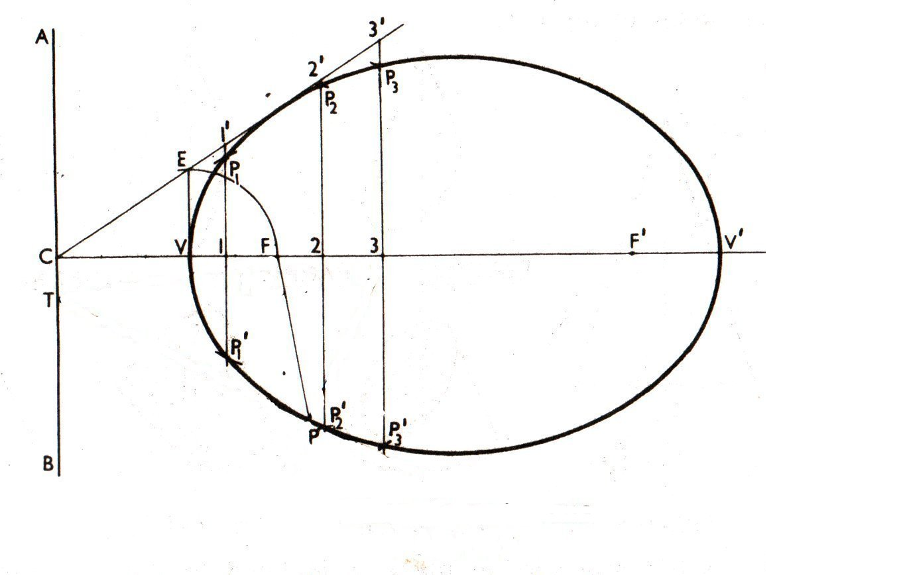
Tangent and Normals to Conics
1
When a tangent at any
point on the curve is
produced to meet the
directrix, the line joining the
focus with this meeting
point will be at right angles
to the line joining the focus
with the point of contact.

Slide 19
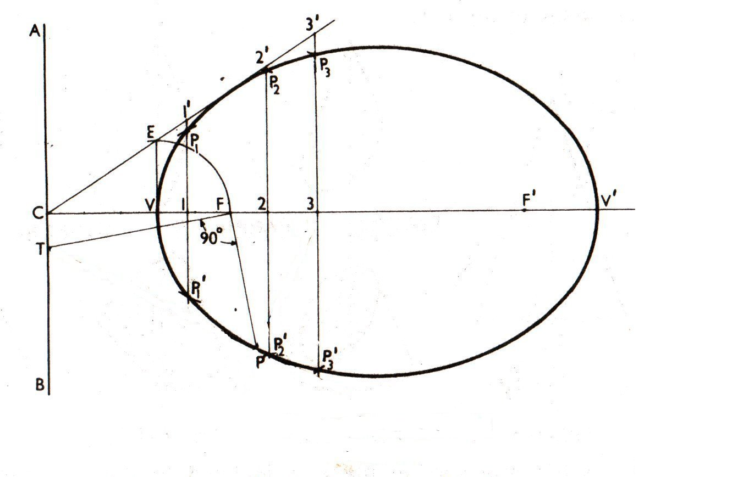
Tangent and Normals to Conics
1
When a tangent at any
point on the curve is
produced to meet the
directrix, the line joining the
focus with this meeting
point will be at right angles
to the line joining the focus
with the point of contact.

Slide 20
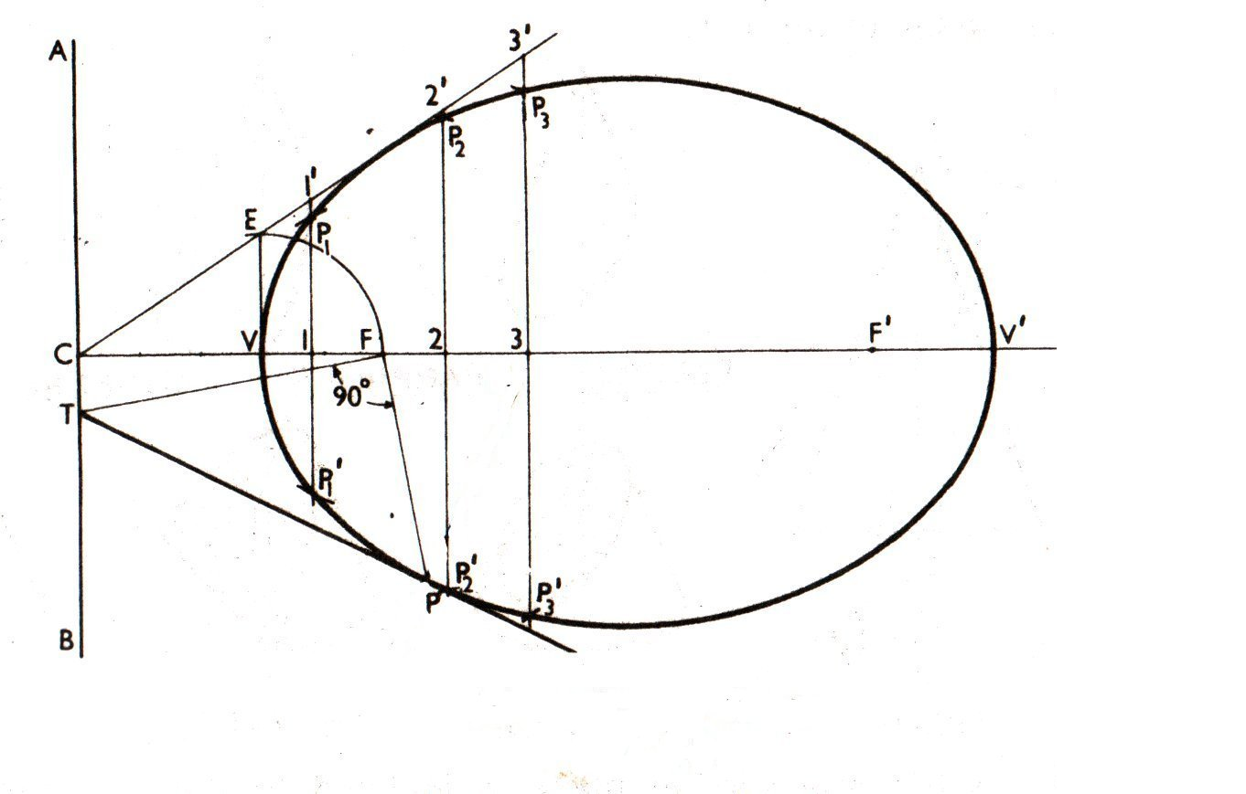
Tangent and Normals to Conics
1
When a tangent at any
point on the curve is
produced to meet the
directrix, the line joining the
focus with this meeting
point will be at right angles
to the line joining the focus
with the point of contact.

Slide 21
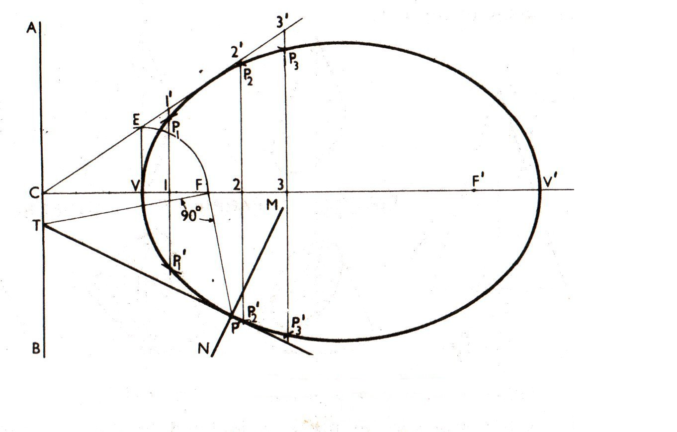
Tangent and Normals to Conics
1
When a tangent at any
point on the curve is
produced to meet the
directrix, the line joining the
focus with this meeting
point will be at right angles
to the line joining the focus
with the point of contact.

Slide 22
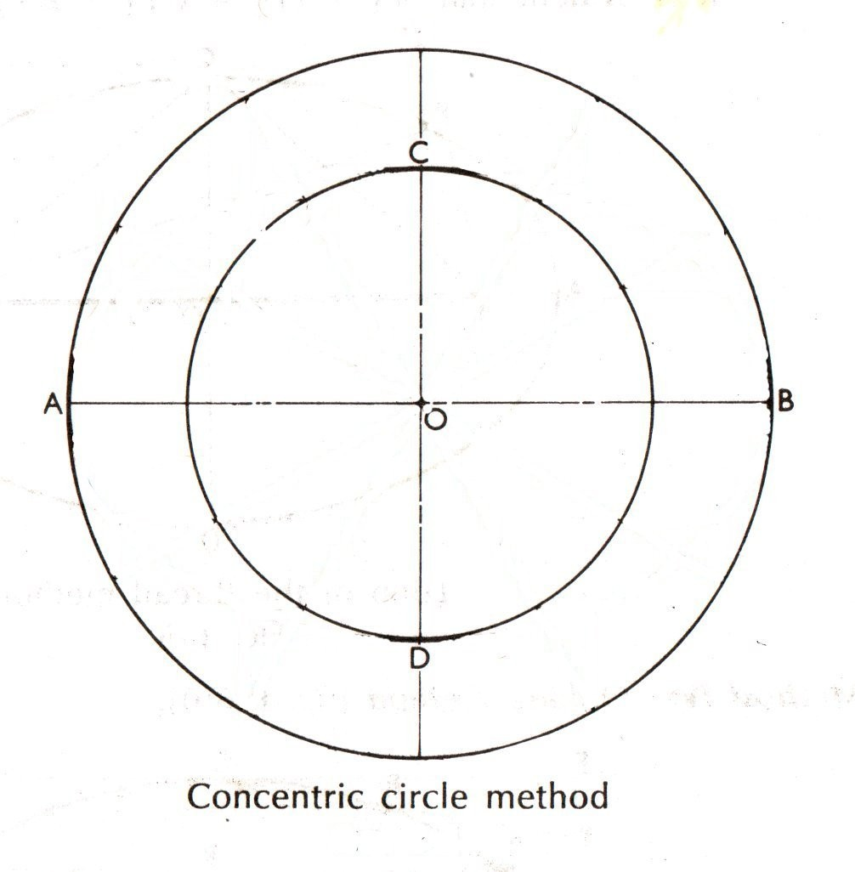
Ellipse from Major and Minor Axis
1
Draw major and minor axes
and two circles.

Slide 23
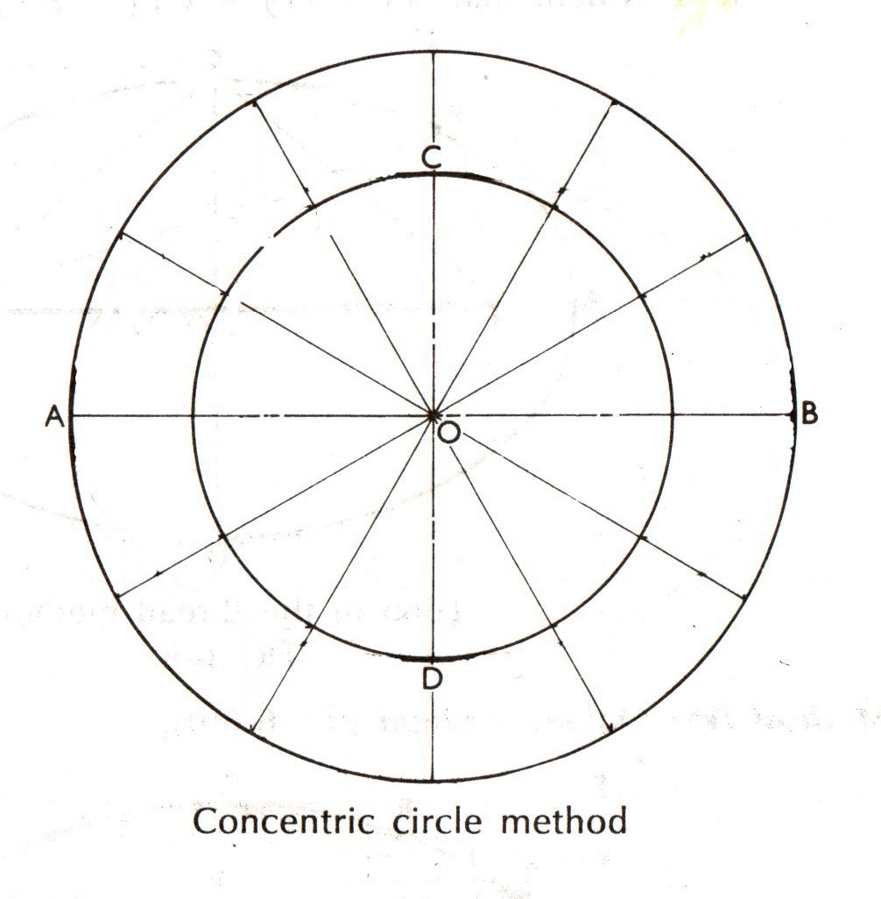
Ellipse from Major and Minor Axis
1
Draw major and minor axes
and two circles.
2
Divide it for sufficient points
to draw the ellipse.

Slide 24
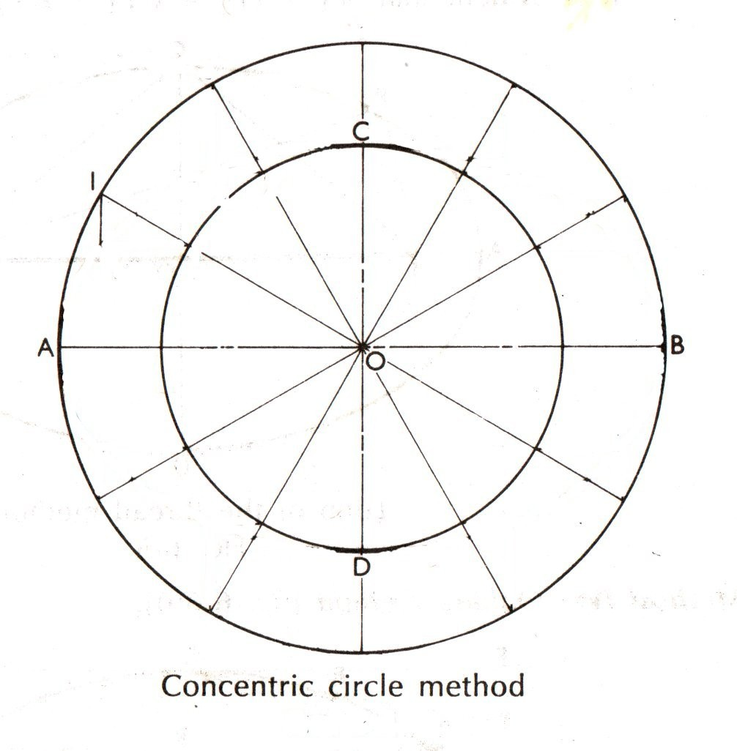
Ellipse from Major and Minor Axis
1
Draw major and minor axes
and two circles.
2
Divide it for sufficient points
to draw the ellipse.
3
Draw a vertical at 1.

Slide 25
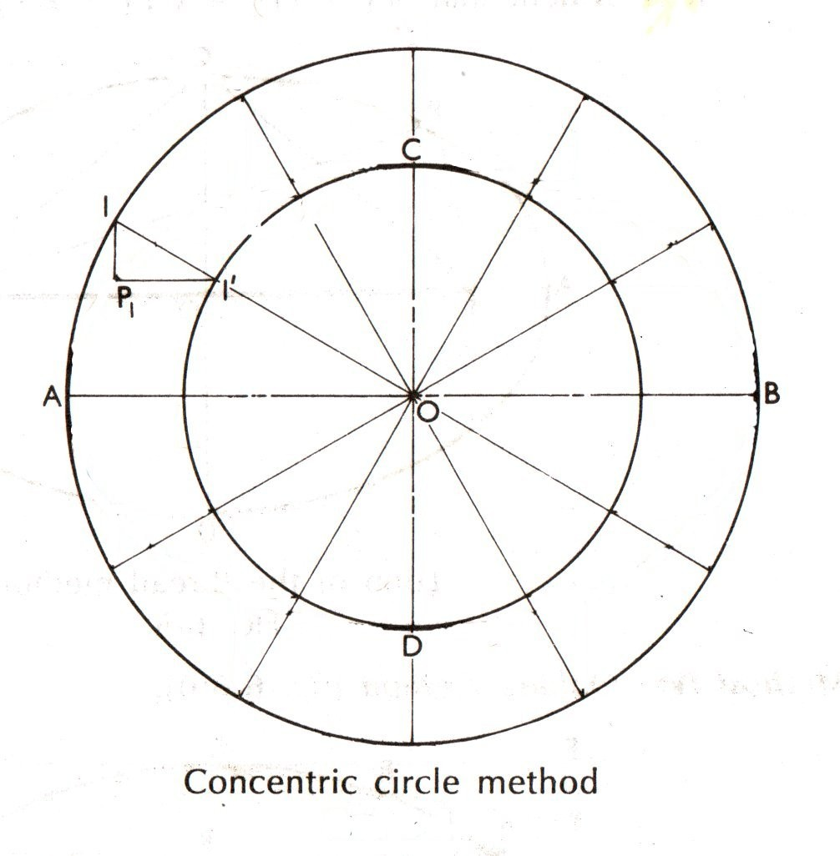
Ellipse from Major and Minor Axis
1
Draw major and minor axes
and two circles.
2
Divide it for sufficient points
to draw the ellipse.
3
Draw a vertical at 1.
Draw horizontal at 1‘
4

Slide 26
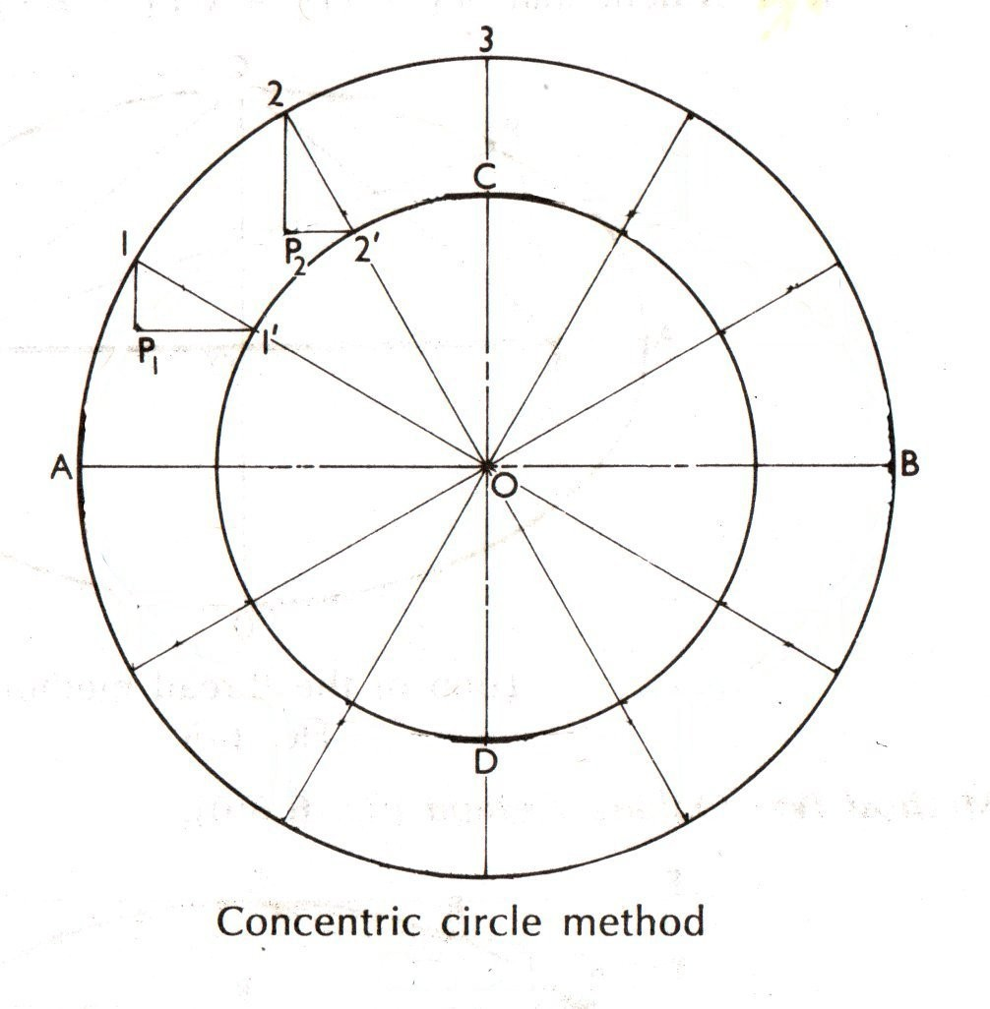
Ellipse from Major and Minor Axis
1
Draw major and minor axes
and two circles.
2
Divide it for sufficient points
to draw the ellipse.
3
Draw a vertical at 1.
Draw horizontal at 1‘
Repeat the procedure described in the last two steps
4
5

Slide 27
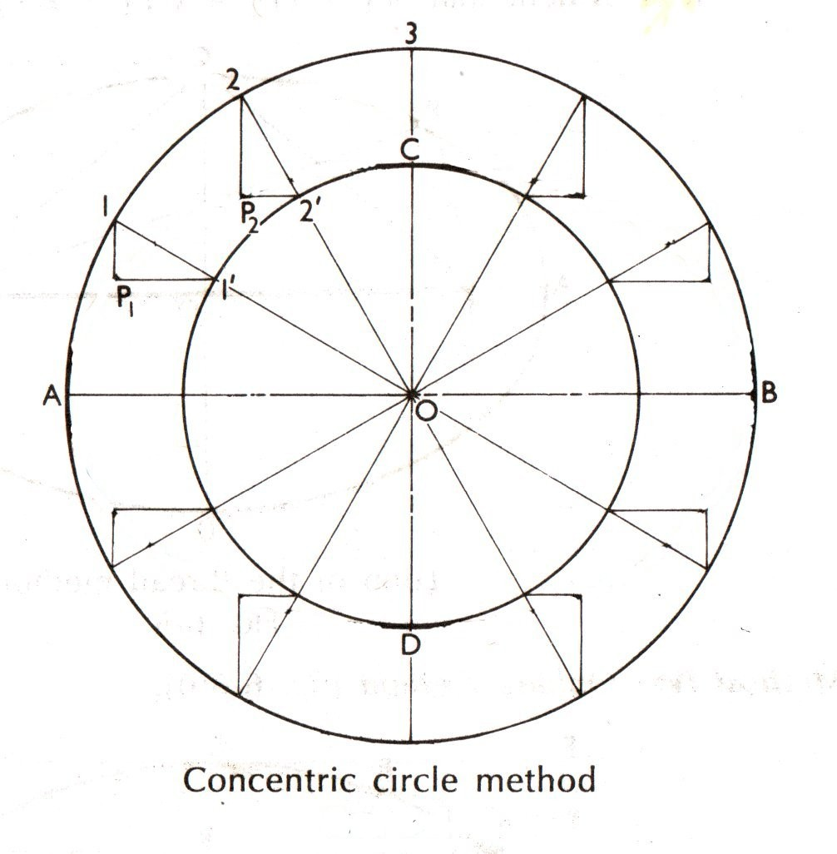
Ellipse from Major and Minor Axis
1
Draw major and minor axes
and two circles.
2
Divide it for sufficient points
to draw the ellipse.
3
Draw a vertical at 1.
Draw horizontal at 1‘
Repeat the procedure described in the last two steps
4
5

Slide 28
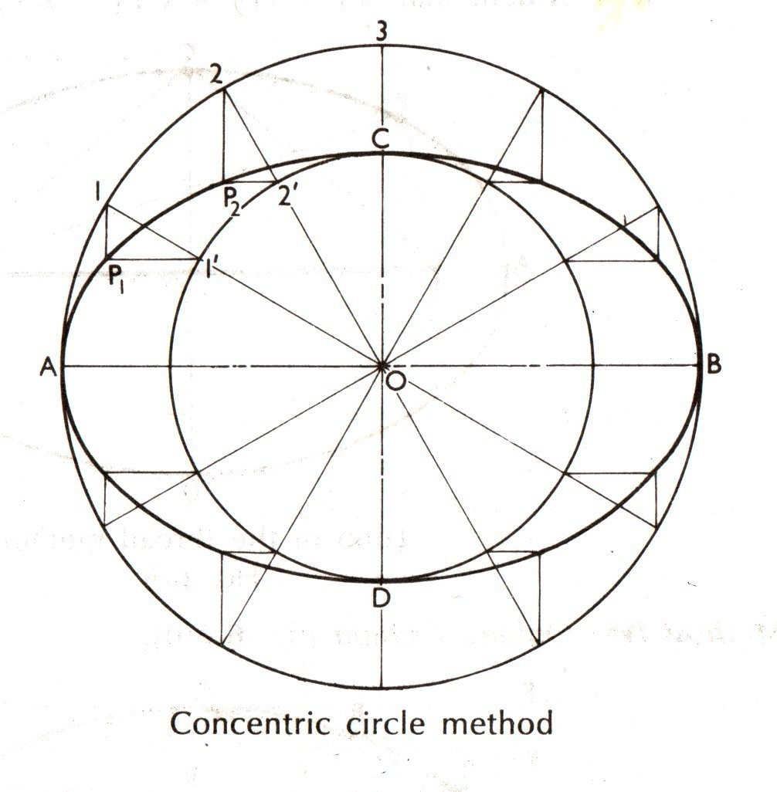
Ellipse from Major and Minor Axis
1
Draw major and minor axes
and two circles.
2
Divide it for sufficient points
to draw the ellipse.
3
Draw a vertical at 1.
Draw horizontal at 1‘
Repeat the procedure described in the last two steps
4
5

Slide 29
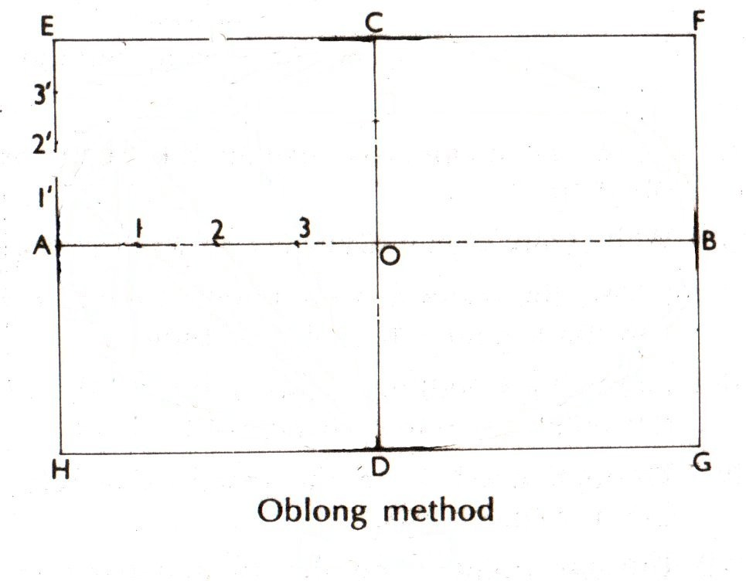
Ellipse by Oblong method
1
Divide AO and AE in equal
segments (4)

Slide 30
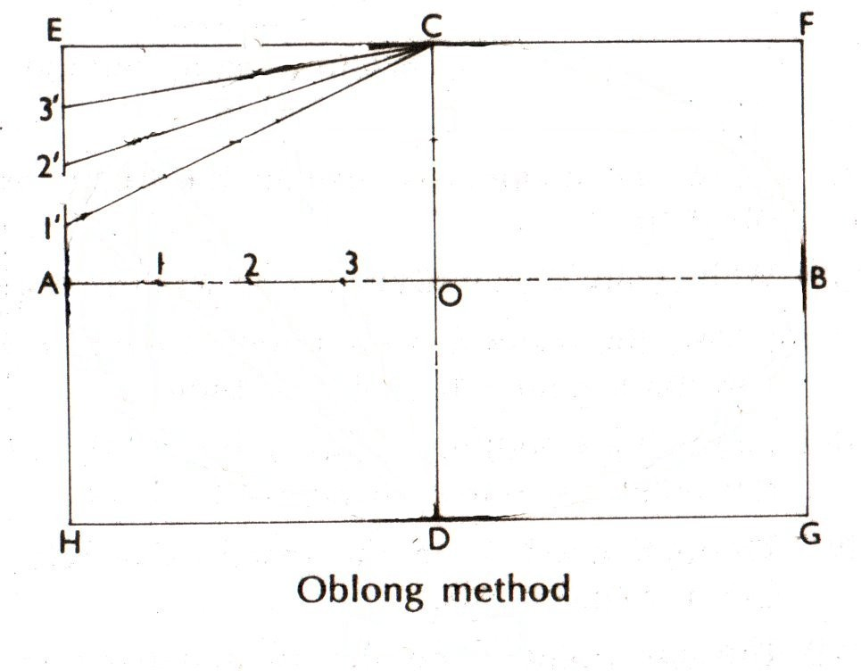
Ellipse by Oblong method
1
Divide AO and AE in equal
segments (4)
Join 1‘ , 2‘ and 3‘ to C
2

Slide 31
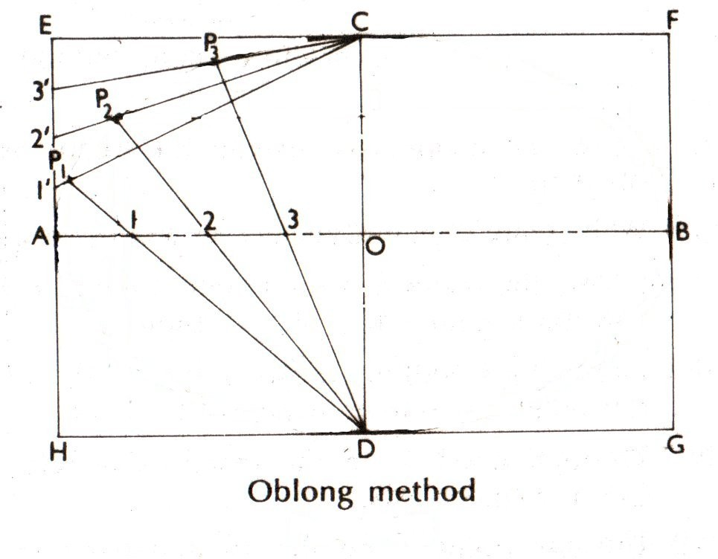
Ellipse by Oblong method
1
Divide AO and AE in equal
segments (4)
Join 1‘ , 2‘ and 3‘ to C
Join 1, 2 and 3 with D and extend
2
3

Slide 32
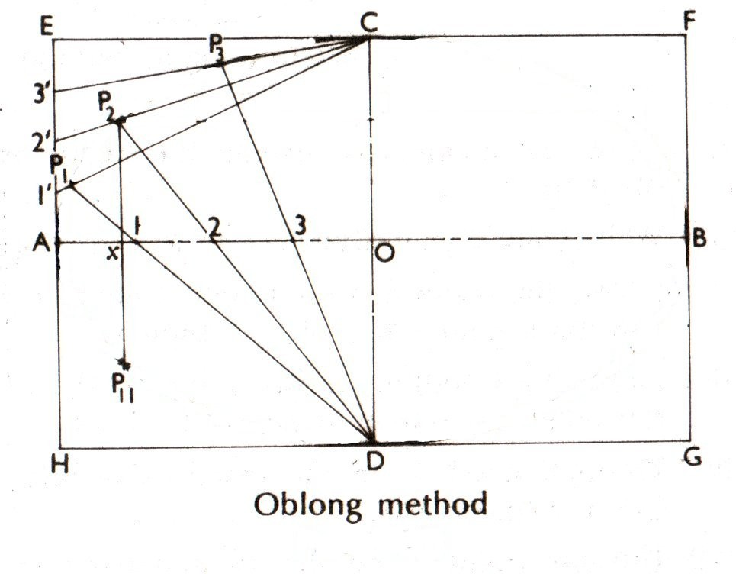
Ellipse by Oblong method
1
Divide AO and AE in equal
segments (4)
Join 1‘ , 2‘ and 3‘ to C
Join 1, 2 and 3 with D and extend
2
3
4
On vertical P2 P11 cut
P2 x = xP11

Slide 33
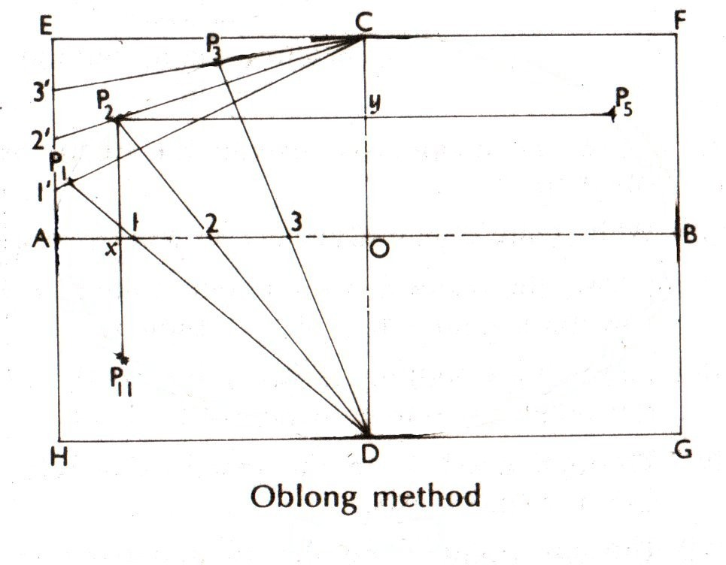
Ellipse by Oblong method
1
Divide AO and AE in equal
segments (4)
Join 1‘ , 2‘ and 3‘ to C
Join 1, 2 and 3 with D and extend
2
3
4
On vertical P2 P11 cut
P2 x = xP11
On horizontal P2 P5 cut
P2 y = yP5
5

Slide 34
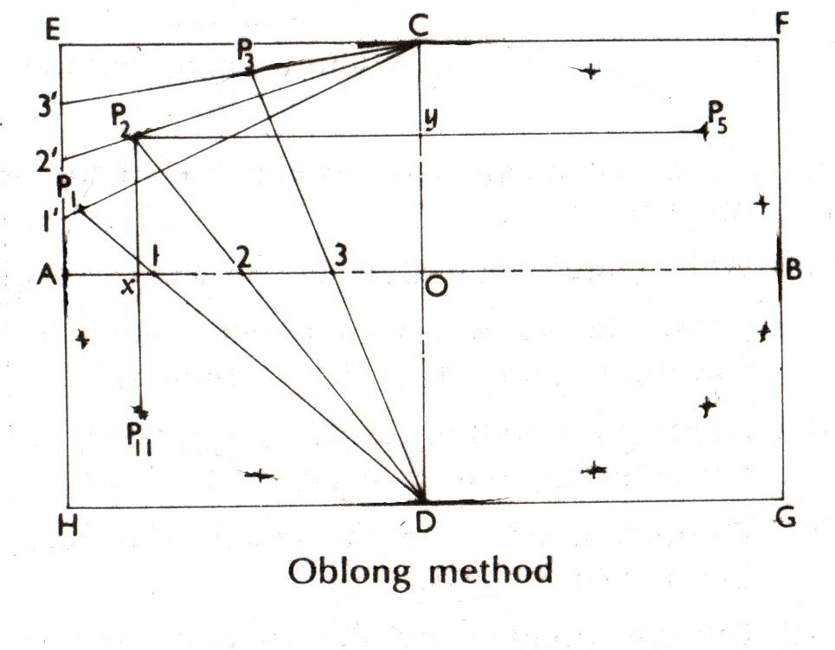
Ellipse by Oblong method
1
Divide AO and AE in equal
segments (4)
Join 1‘ , 2‘ and 3‘ to C
Join 1, 2 and 3 with D and extend
2
3
4
On vertical P2 P11 cut
P2 x = xP11
On horizontal P2 P5 cut
P2 y = yP5
Find other point similarly
5
6

Slide 35
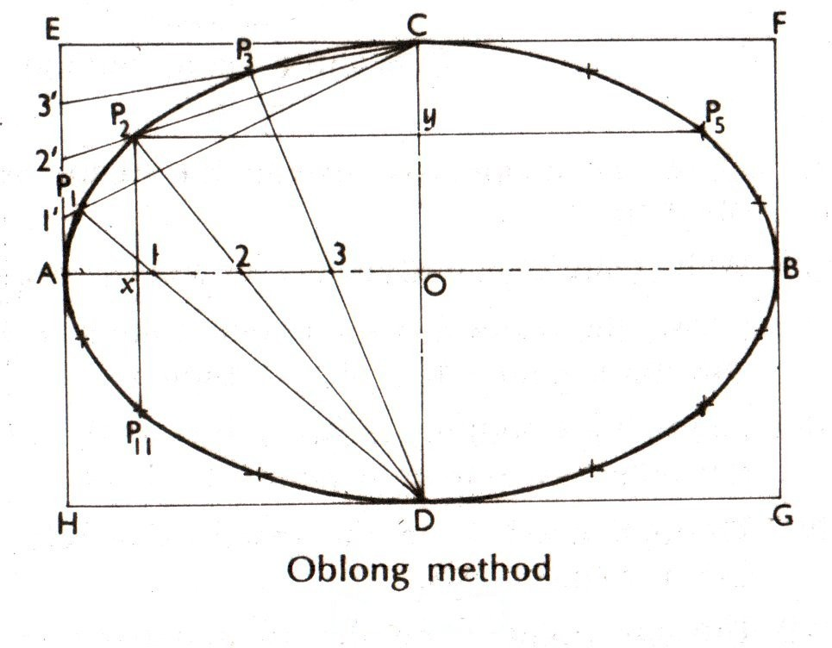
Ellipse by Oblong method
1
Divide AO and AE in equal
segments (4)
Join 1‘ , 2‘ and 3‘ to C
Join 1, 2 and 3 with D and extend
2
3
4
On vertical P2 P11 cut
P2 x = xP11
On horizontal P2 P5 cut
P2 y = yP5
Find other point similarly
5
6

Slide 36
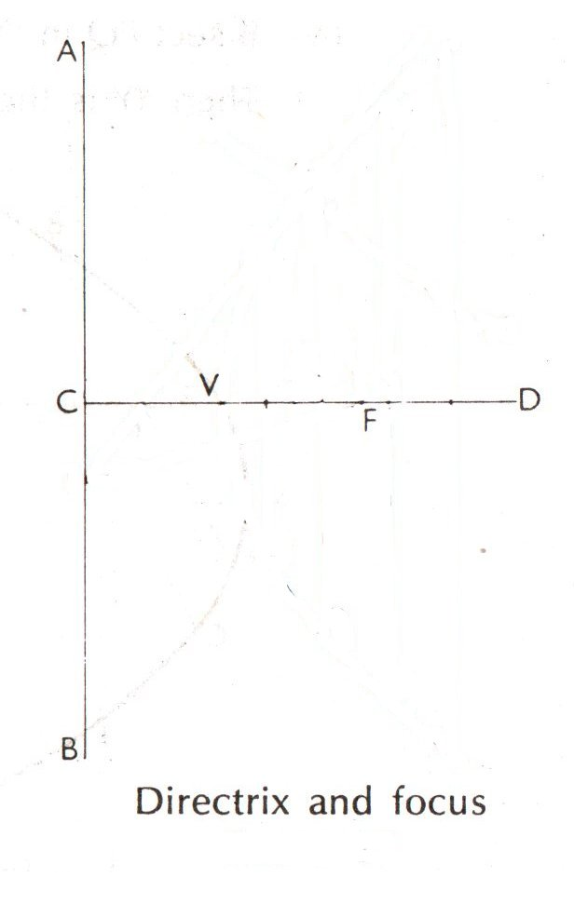
Parabola for a given focus distance
1
Bisect CF for the vertex V
with proper process.

Slide 37
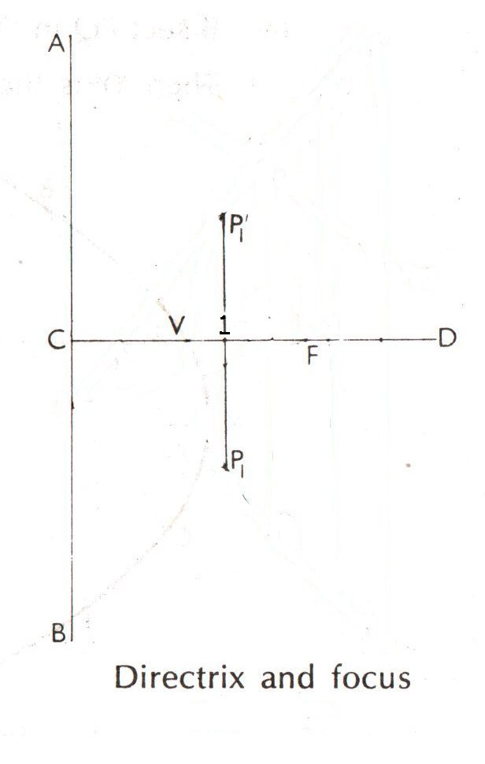
Parabola for a given focus distance
1
Bisect CF for the vertex V
with proper process.
2
Draw a vertical at 1 and cut
FP ‘ and FP1 = C1.
1

Slide 38
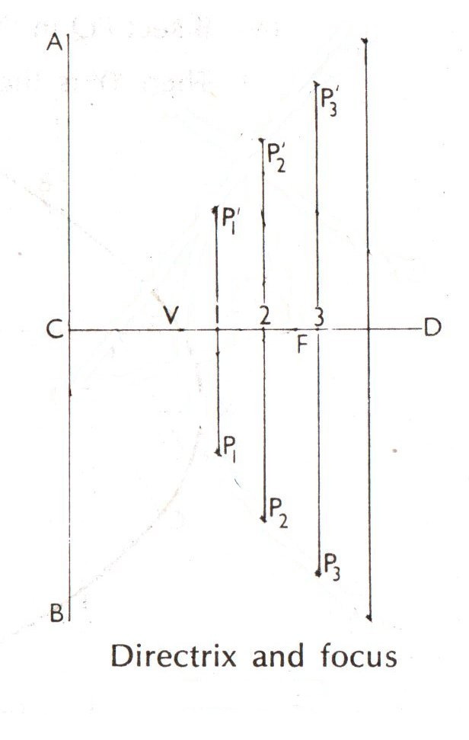
Parabola for a given focus distance
1
Bisect CF for the vertex V
with proper process.
2
Draw a vertical at 1 and cut
FP ‘ and FP1 = C1.
1
3
Repeat for more points.

Slide 39
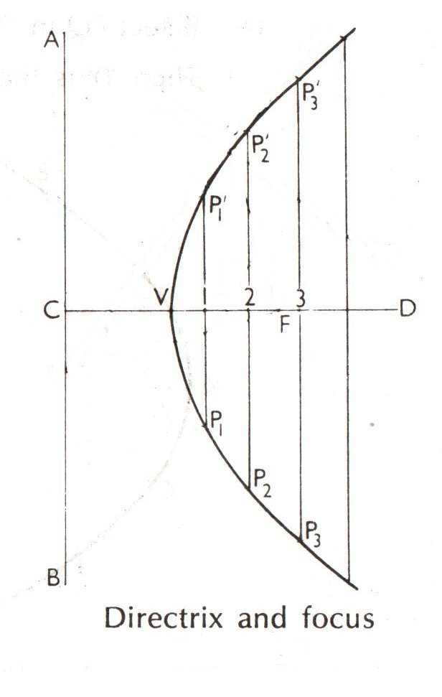
Parabola for a given focus distance
1
Bisect CF for the vertex V
with proper process.
2
Draw a vertical at 1 and cut
FP ‘ and FP1 = C1.
1
3
Repeat for more points.

Slide 40
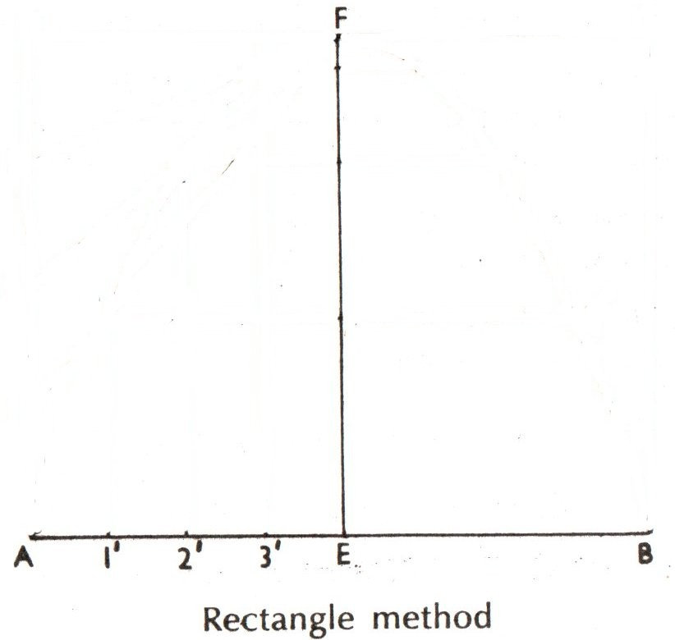
Parabola for a given base and axis
1
Draw the base AB and axis
EF from mid point E.

Slide 41
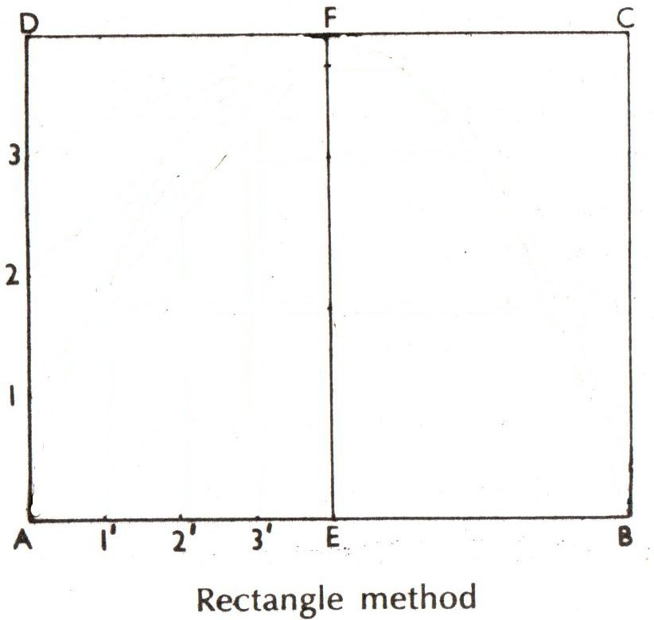
Parabola for a given base and axis
1
Draw the base AB and axis
EF from mid point E.
2
Construct rectangle ABCD
and divide AB and CD in equal parts.

Slide 42
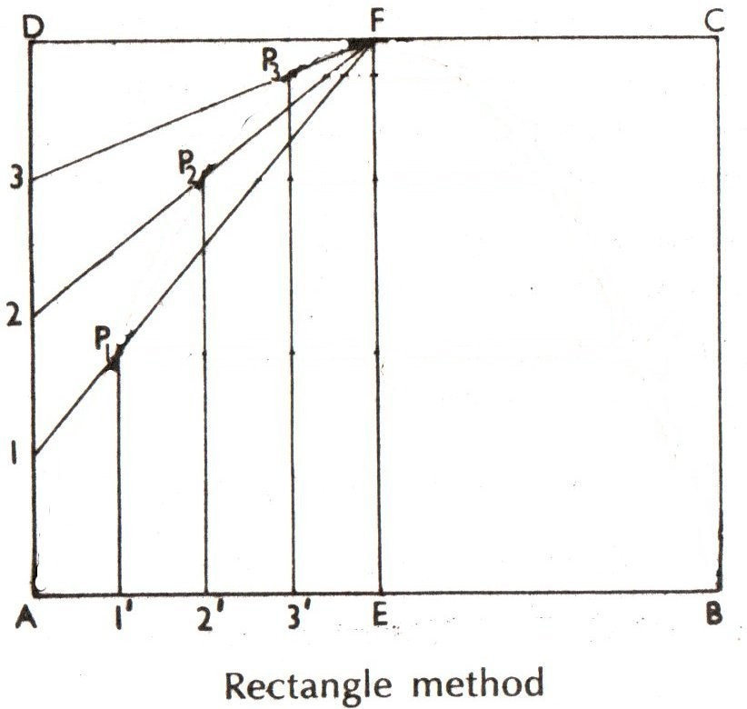
Parabola for a given base and axis
1
Draw the base AB and axis
EF from mid point E.
2
Construct rectangle ABCD
and divide AB and CD in equal parts.
3
Draw lines F1, F2, F3 and
perpendiculars 1‘ P1 , 2‘ P2
and 3‘ P3 .

Slide 43
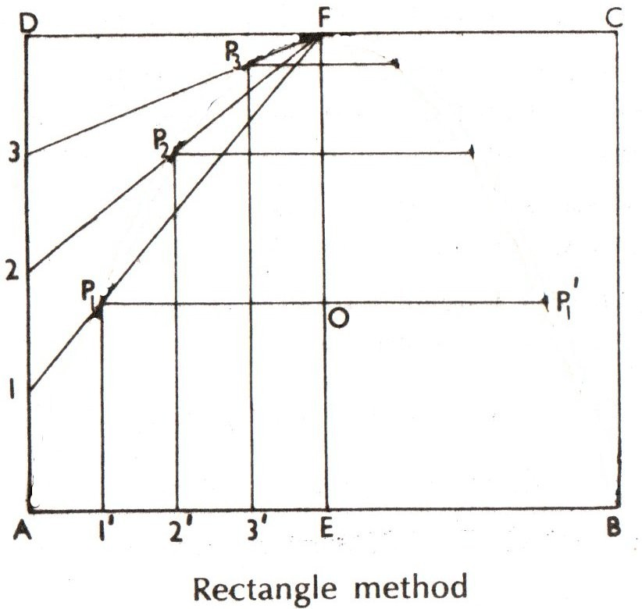
Parabola for a given base and axis
1
Draw the base AB and axis
EF from mid point E.
2
Construct rectangle ABCD
and divide AB and CD in equal parts.
3
Draw lines F1, F2, F3 and
perpendiculars 1‘ P1 , 2‘ P2
and 3‘ P3 .
Cut points like P ‘ ....
4
1

Slide 44
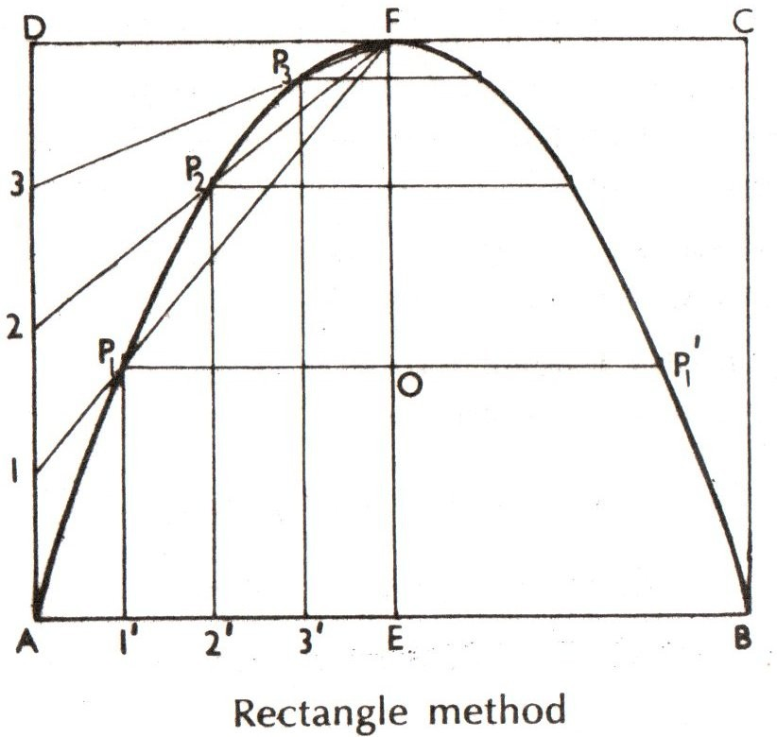
Parabola for a given base and axis
1
Draw the base AB and axis
EF from mid point E.
2
Construct rectangle ABCD
and divide AB and CD in equal parts.
3
Draw lines F1, F2, F3 and
perpendiculars 1‘ P1 , 2‘ P2
and 3‘ P3 .
Cut points like P ‘ ....
4
1

Slide 45
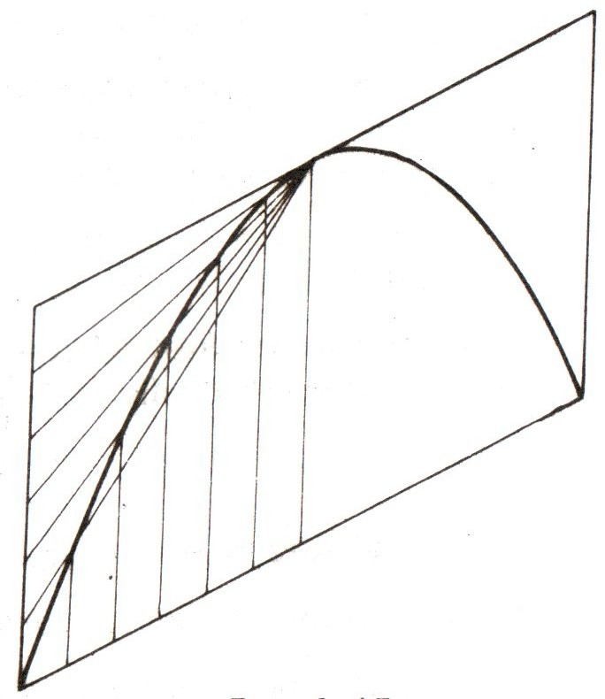
Parabola in Parrallelogram
Follow similar process.

Slide 46
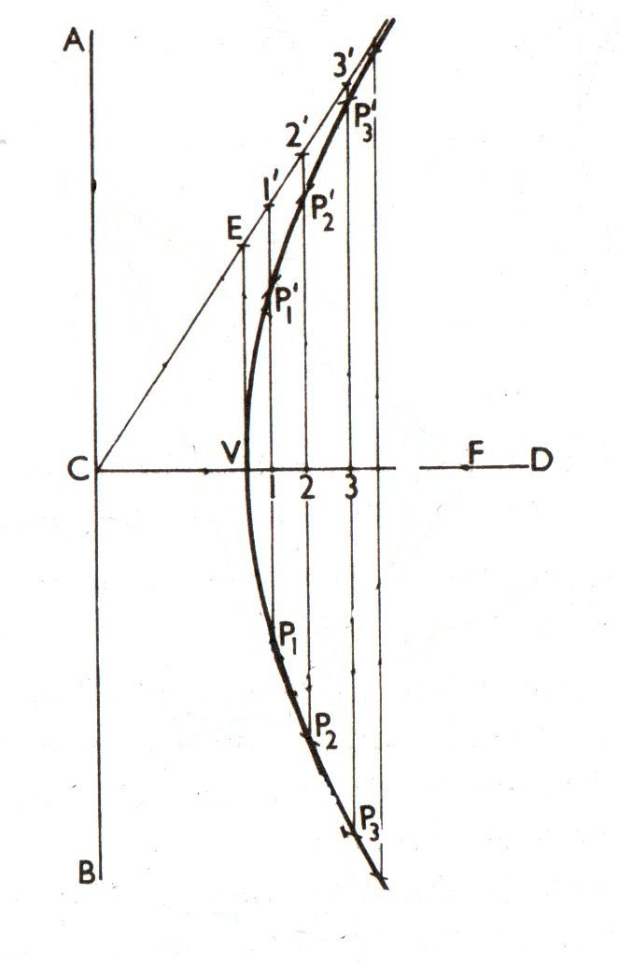
Hyperbola for a given eccentricity
Follow similar process.

Slide 47
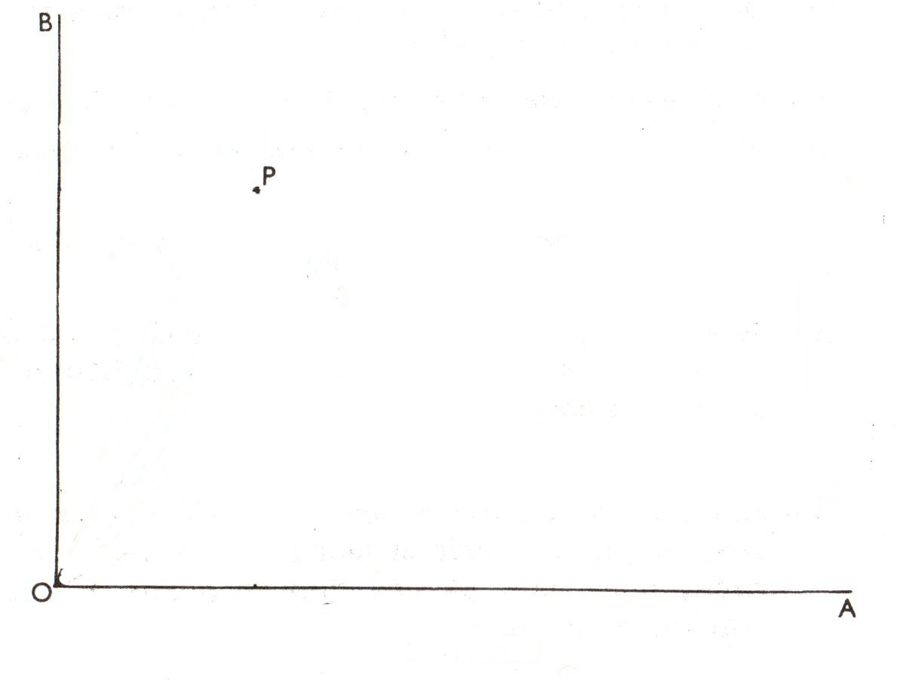
Rectangular Hyperbola through a given point
( e = √2 and equation may be assumed as xy = 1 not x ² − y ² = 1)
1
Draw the axes OA, OB and
mark point P.

Slide 48
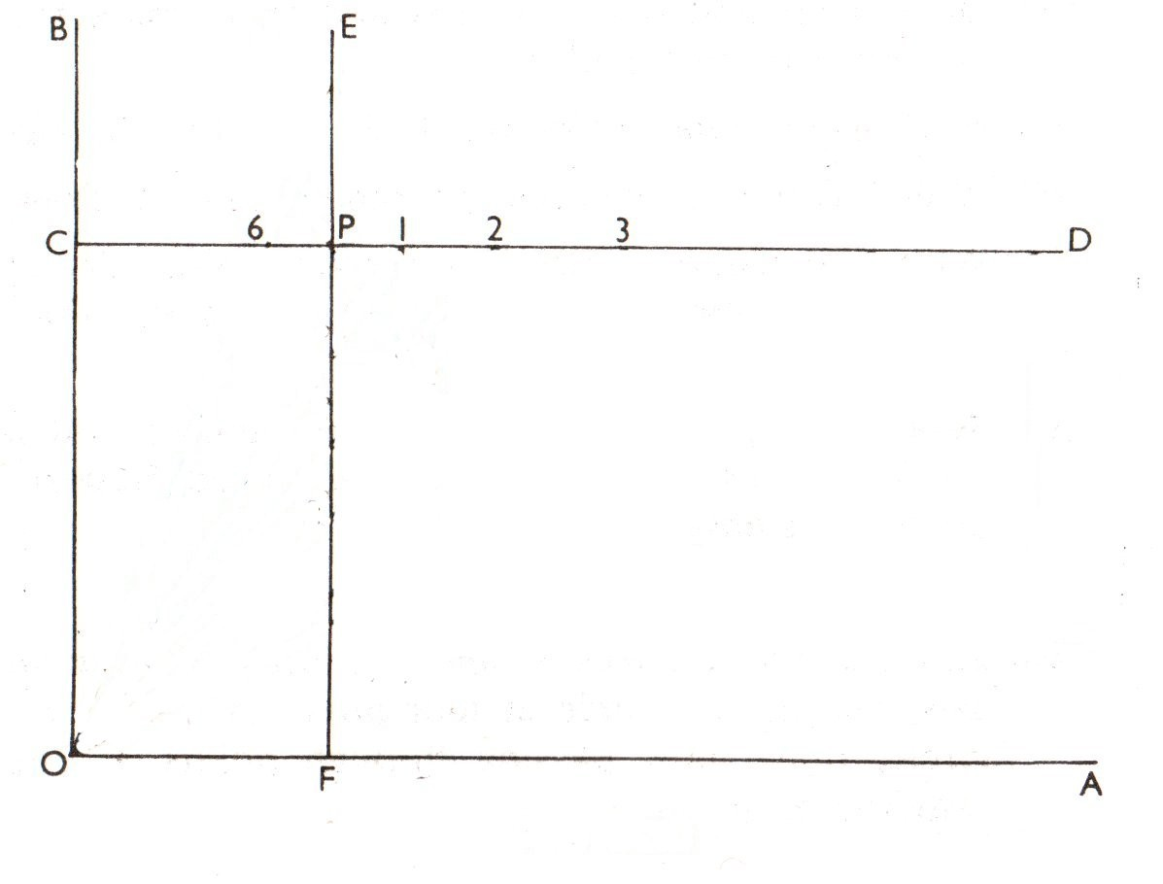
Rectangular Hyperbola through a given point
( e = √2 and equation may be assumed as xy = 1 not x ² − y ² = 1)
1
Draw the axes OA, OB and
mark point P.
2
Draw CD k OA, EF k OB .

Slide 49
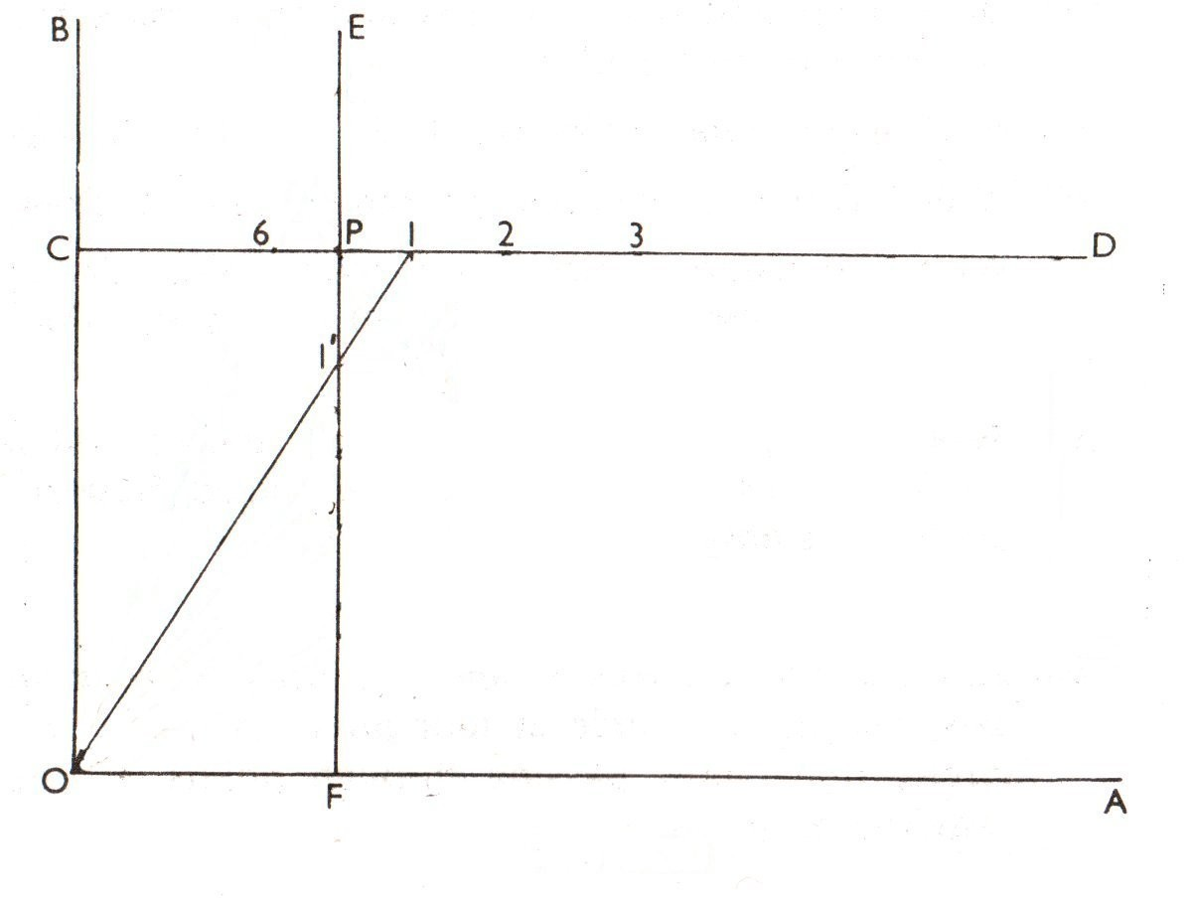
Rectangular Hyperbola through a given point
( e = √2 and equation may be assumed as xy = 1 not x ² − y ² = 1)
1
Draw the axes OA, OB and
mark point P.
2
Draw CD k OA, EF k OB .
Mark points 1, 2, 3 ... (may not be equidistant)
3

Slide 50
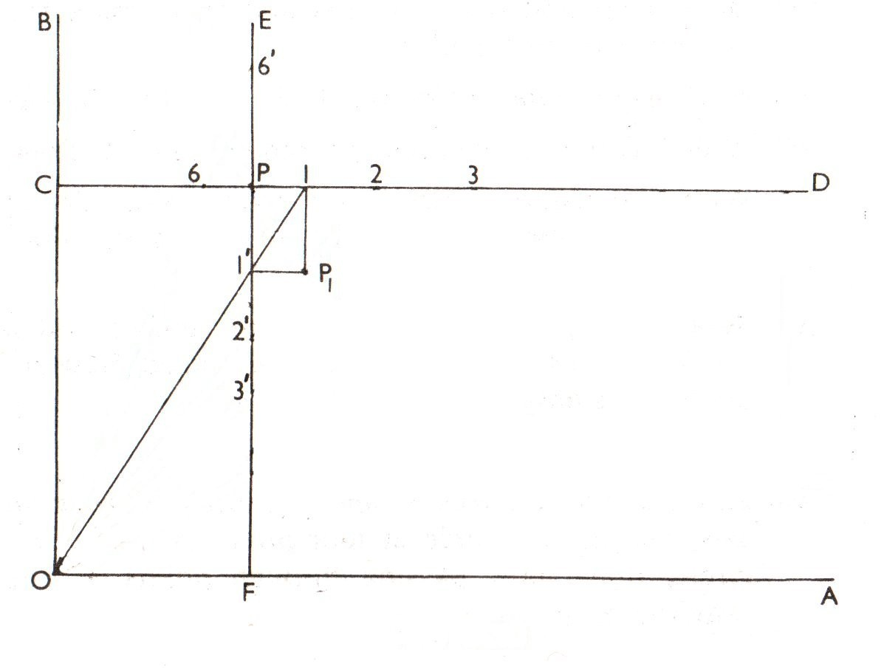
Rectangular Hyperbola through a given point
( e = √2 and equation may be assumed as xy = 1 not x ² − y ² = 1)
1
Draw the axes OA, OB and
mark point P.
2
Draw CD k OA, EF k OB .
Mark points 1, 2, 3 ... (may not be equidistant)
3
4
Join O1 and 1P1 k OB and
1‘ P1 k OA to find P1

Slide 51
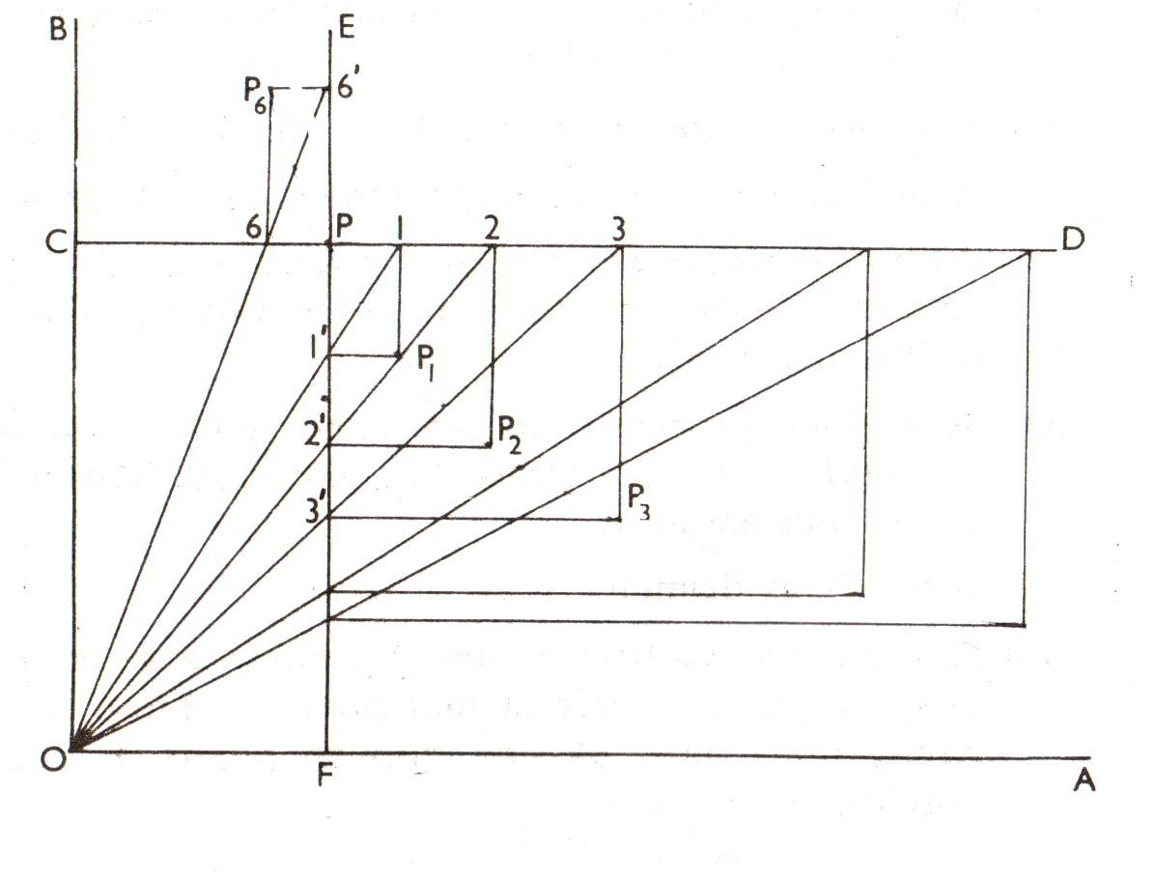
Rectangular Hyperbola through a given point
( e = √2 and equation may be assumed as xy = 1 not x ² − y ² = 1)
1
Draw the axes OA, OB and
mark point P.
2
Draw CD k OA, EF k OB .
Mark points 1, 2, 3 ... (may not be equidistant)
3
4
Join O1 and 1P1 k OB and
1‘ P1 k OA to find P1
Find the other points similarly.
5

Slide 52

Rectangular Hyperbola through a given point
( e = √2 and equation may be assumed as xy = 1 not x ² − y ² = 1)
1
Draw the axes OA, OB and
mark point P.
2
Draw CD k OA, EF k OB .
Mark points 1, 2, 3 ... (may not be equidistant)
3
4
Join O1 and 1P1 k OB and
1‘ P1 k OA to find P1
Find the other points similarly.
5

Slide 53

Length of an Arc
Length of an arc subtending an angle less than 60⁰ and length of circumference.

Slide 54

Cycloidal Curves
The curve generated by a fixed point on the circumference of a circle, which rolls
without slipping along a fixed straight line or a circle. Circle = generating circle. The line or circle = directing line or circle. Used in tooth profile of gears of a dial gauge.
1
Let P is the generating point and PA is the circumference of the circle.

Slide 55
Cycloidal Curves
The curve generated by a fixed point on the circumference of a circle, which rolls
without slipping along a fixed straight line or a circle. Circle = generating circle. The line or circle = directing line or circle. Used in tooth profile of gears of a dial gauge.
1
Let P is the generating point and PA is the circumference of the circle.
Divide PA and the circle in equal parts say 12.
Draw CBkPA and CB = PA and mark 1, 2, 3 .. and C1 , C2 , .. .
2
3

Slide 56

Cycloidal Curves
The curve generated by a fixed point on the circumference of a circle, which rolls
without slipping along a fixed straight line or a circle. Circle = generating circle. The line or circle = directing line or circle. Used in tooth profile of gears of a dial gauge.
1
Let P is the generating point and PA is the circumference of the circle.
Divide PA and the circle in equal parts say 12.
Draw CBkPA and CB = PA and mark 1, 2, 3 .. and C1 , C2 , .. .
Draw lines through 1‘ , 2‘ , ... k PA.
With center C1 and radius R mark P1 on line through 1‘ .
2
3
4
5

Slide 57

Cycloidal Curves
The curve generated by a fixed point on the circumference of a circle, which rolls
without slipping along a fixed straight line or a circle. Circle = generating circle. The line or circle = directing line or circle. Used in tooth profile of gears of a dial gauge.
1
Let P is the generating point and PA is the circumference of the circle.
Divide PA and the circle in equal parts say 12.
Draw CBkPA and CB = PA and mark 1, 2, 3 .. and C1 , C2 , .. .
Draw lines through 1‘ , 2‘ , ... k PA.
With center C1 and radius R mark P1 on line through 1‘ .
2
3
4
5

Slide 58

Tangent to a Cycloid Curve
The normal at any point on a cycloidal curve will pass through the corresponding
point of contact between the generating circle and the directing line or circle.

Slide 59
Trochoid Curves
curve generated by a point fixed to a circle, within or outside its circumference, as the
circle rolls along a straight line. Point within the circle = inferior trochoid, Point outside the circle = superior trochoid,
1
Process is similar to the previous. We need to extend the lines C1 P1 , C2 P2 , ..
and cut the appropriate lengths like radius R1 or R2 from the lines.

Slide 60

Involute
The curve traced out by an end of a piece of thread unwound from a circle or a
plygon, the thread being kept tight.
1
Divide PQ (= perimeter)
and circle in equal parts
(say 12).

Slide 61
Involute
The curve traced out by an end of a piece of thread unwound from a circle or a
plygon, the thread being kept tight.
1
Divide PQ (= perimeter)
and circle in equal parts
(say 12).
2
Draw tangents at 1 and cut
P1’ on the tangent.

Slide 62
Involute
The curve traced out by an end of a piece of thread unwound from a circle or a
plygon, the thread being kept tight.
1
Divide PQ (= perimeter)
and circle in equal parts
(say 12).
2
Draw tangents at 1 and cut
P1’ on the tangent.
3
Repeat for further points.

Slide 63
Involute
The curve traced out by an end of a piece of thread unwound from a circle or a
plygon, the thread being kept tight.
1
Divide PQ (= perimeter)
and circle in equal parts
(say 12).
2
Draw tangents at 1 and cut
P1’ on the tangent.
3
Repeat for further points.
4
To draw tangent and normal
at any point N draw CN,

Slide 64
Involute
The curve traced out by an end of a piece of thread unwound from a circle or a
plygon, the thread being kept tight.
1
Divide PQ (= perimeter)
and circle in equal parts
(say 12).
2
Draw tangents at 1 and cut
P1’ on the tangent.
3
Repeat for further points.
4
To draw tangent and normal
at any point N draw CN,
5
With diameter CN describe
a semicircle to find tangent point M.

