Slide 1
ELECTIVE – I
AUTOMOBILE ENGINEERING
Prepared By
Prof. M. N. Nasim
M.E (Thermal Engineering), B.E (Mechanical)
Anjuman College of Engineering & Technology, Sadar, Nagpur

Slide 2
VISION OF COLLEGE
“To be a center of excellence for developing technocrats with moral and social ethics to face the global challenges for the sustainable development of the society.”
MISSION OF COLLEGE
We at Anjuman College of Engineering & Technology are committed:
To create conducive academic culture for the learning and identifying career goals.
To provide quality technical education, research opportunities and imbibe entrepreneurship skills, contributing to the socioeconomic growth of the nation.
To inculcate values and skills, that will empower our students towards development through technology
1

Slide 3
Vision of the Mechanical Department:
“To impart technical education for facing challenges with humane approach for sustainable development in Mechanical Engineering.”
Mission of the Mechanical Department:
To provide an environment for technical knowledge gain for overall development of students.
To create awareness and provide environment for research.
To instill spirit, commitment and develop skills in students for socio economic development.
To guide students for adopting engineering approach to conserve natural resources.

Slide 4
Program Educational Objectives (PEOs)
To have strong aptitude and fundamental knowledge in mechanical engineering for successful career.
To take up research based improvement to provide solutions for technical problems of society.
To resolve societal, technical /business challenges to hone personal development.
Enhance professional progress and technical understanding through continuing education for sustainable development.
Program Specific Outcomes (PSOs)
Able to apply, analyze mechanical engineering knowledge for sustainable development of society and self.
Able to effectively communicate in small and large teams and work as a team member
Able to use creativity in design, thermal, industrial engineering to improve mechanical systems and processes.

Slide 5
BEME702T3: ELECTIVE – I: AUTOMOBILE ENGINEERING (Theory)
Course Outcome
CO No | Student shall be able to understand and define
CO702.1: | fundamental working principles and technologies in automotive engineering.
CO702.2: | different types of semiautomatic & automatic transmission and its application.
CO702.3: | Various types of brakes used in modern automotive vehicle
CO702.4: | Principle and functioning of steering and suspension system for advanced Automobile.
CO702.5: | Electrical system and air conditioning used in automobile.
CO702.6: | Body and Safety Considerations and Modern Developments in Automobiles
1

Slide 6
BEME702T3: ELECTIVE – I: AUTOMOBILE ENGINEERING (Theory)
CREDITS: 04
Teaching Scheme Examination Scheme
Lectures: 3 Hours/Week Duration of Paper: 03 Hours
Tutorial: 1 Hour/Week University Assessment: 80 Marks
College Assessment: 20 Marks
Course Objectives and Expected Outcomes: This course is designed to understand the basic concepts of automobile and its components. It includes information of different chassis, frame, power plant, clutch, gear box, transmission system, brakes, steering systems, wheels, tyres, suspension systems and electrical systems used in automobile. At the end of this course, students will be able to understand the basics about the vehicle, its components and recent advances in automobiles.
1

Slide 7
UNIT – I [ 8 Hrs.]
Introduction, Automobile history and development.
Chassis and Frame: Layout of chassis & its main components. Types of frames, conventional frames and unitized chassis, articulated, rigid vehicles, prime movers, hybrid car & electric car.
Power Plant: Constructional features of different types of engines used in automobiles. Fuel supply systems, cooling systems, lubrication systems.
UNIT – II [ 8 Hrs.]
Clutch: Necessity, requirements of a clutch system. Types of Clutches, centrifugal clutch, single &
multi plate clutch, fluid clutch.
Gear Box: Necessity of transmission, principle, types of transmission, sliding mesh, constant mesh,
synchromesh, transfer gear box, gear selector mechanism, lubrication and control. Torque
converter, semiautomatic & automatic transmission.
UNIT – III [ 8 Hrs.]
Transmission system: Propeller shaft, universal joint, Hotchkiss drive, torque tube drive.
Differential – Need and types. Rear axles and Front axles.
Brakes: Need & types, mechanical, hydraulic & pneumatic brakes, electrical brakes, engine exhaust
brakes, drum and disc brakes, comparison and details of components. Brake adjustment.
1

Slide 8
UNIT – IV [ 8 Hrs.]
Steering systems: principle of steering, center point steering, steering linkages, steering geometry
and wheel alignment, power steering.
Suspension systems: Function of spring and shock absorber, conventional and Independent suspension system, Telescopic shock absorber, linked suspension systems, rubber, plastic, hydro & pneumatic suspension system.
.
UNIT – V [ 8 Hrs.]
Electrical systems: Battery construction, maintenance, testing and charging, cutout, lighting circuit, horn, side indicator, wiper and panel board instruments. Battery, magneto and electronic ignition systems. Automobile air-conditioning.
Wheels and Tyres: Types of wheels, wheel dimensions, tyre, desirable tyre properties, types of tyres, comparison of radial and bias-ply tyres, tyre construction, tyre materials, factor affecting tyre life, precautions regarding the tyres and wheel balancing.
UNIT – VI [ 8 Hrs.]
Body and Safety Considerations and Modern Developments in Automobiles: Requirements of automobile body, materials for body work, safety considerations, crash worthiness. Recent advances in automobiles such as ABS, electronic power steering, Active suspension, collision avoidance, intelligent lighting, navigational aids and electronic brake distribution system.
1

Slide 9
LIST OF TUTORIALS: (Minimum 8)
1) Introduction, automobile history and development.
2) Study of different types of frames, conventional frames & unitized Chassis.
3) Study of different types of engines used in automobiles.
4) Discussion and demonstration of Clutches.
5) Discussion and demonstration of Gear box.
6) Discussion and demonstration of Brakes.
7) Discussion on different steering systems.
8) Discussion on precautions regarding the tyres and wheel balancing.
9) Study of automobile air-conditioning.
10) Safety considerations, crash worthiness.
11) Recent advances in automobiles.
12) Visit to automobile service station/Industry.
1

Slide 10
TEXT BOOKS:
1. Automobile Engineering Vol. I & II, Kirpal Singh, Standard Publishers.
2. Automotive Mechanics, Joseph Heitner, East West Press.
3. Automobile Engineering, R.K.Rajput, Laxmi Publications.
4. Automobile Engineering R.B. Gupta, Satya Prakashan New Delhi
5. Course in Automobile Engineering, Sharma R. P, Dhanpat Rai and Sons.
6.Automobile Engineering, Ramakrishna, PHI Learning Pvt. Ltd.
REFERENCE BOOKS:
1. Automobile Mechanics, Crause, W.H., Tata McGraw Hill.
2. Vehicle and Engine Technology, Heinz Heisler, Arnold London.
3. Automotive Engines, Srinivasan S., Tata McGraw Hill.
4. Motor Vehicle Technology, J.A. Dolan, Heinemann Educational Books.
5. Automobile Engineering Vol. I, II & III, P. S. Gill, Kataria and Sons.
6. Automobile Engineering, K.K. Jain, R.B. Asthana, Tata McGraw Hill.
1

Slide 11
UNIT-I
Introduction
Chassis

Slide 12
What is an ‘Automobile’??
• A vehicle producing power within itself for its propulsion is known as a Self propelled vehicle.
• Eg. Moped, Scooter, motorcycle, Car, jeep, truck, tractor, ships, aircrafts, rocket etc.
• A self propelled vehicle used for transportation of goods & passengers on the ground is called an Automobile.
• Different from Aeronautical vehicles (planes, helicopters, rockets) & marine vehicles (ships, boats, submarines)

Slide 13
Definition of Automobile
• Automobile
is
a
“Self
Propelled
vehicle”
generally
driven
by
IC
Engine
and
it
is
used
for transportation of
passengers
Crouse.
• Examples :
& goods on ground – W. H.
Car, Bus, Truck, Scooter etc.

Slide 14
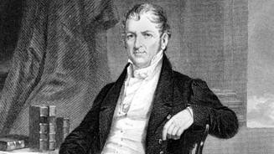
History of Automobiles
Captain Nicholas Joseph Cugnot – French Army – built the first self propelled vehicle in 1768-70

Slide 15
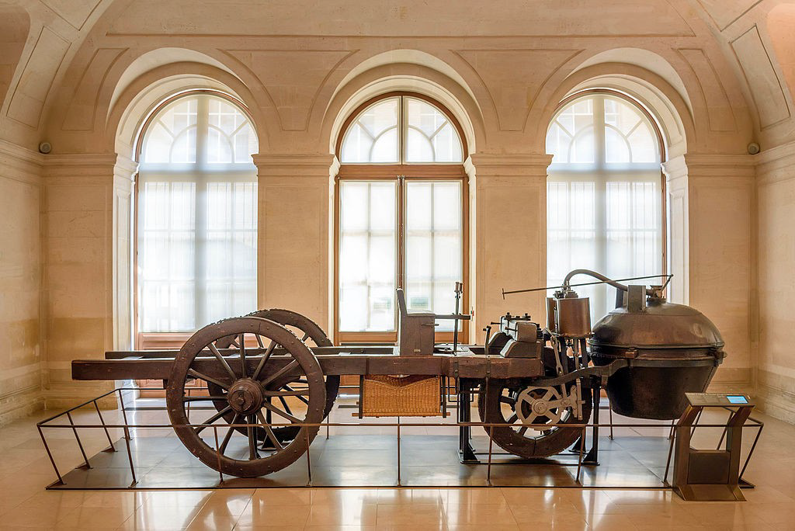
First Automobile
Cugnot Steam Trolley, Steam Engine powered, 1768

Slide 16
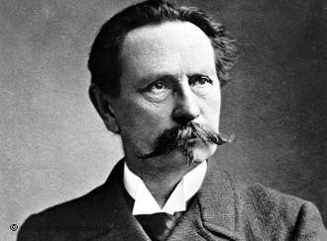
Karl Benz
Inventor of the first gasoline powered automobile, 1886

Slide 17
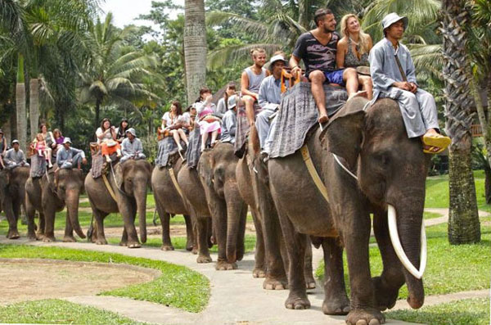
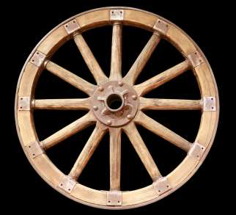
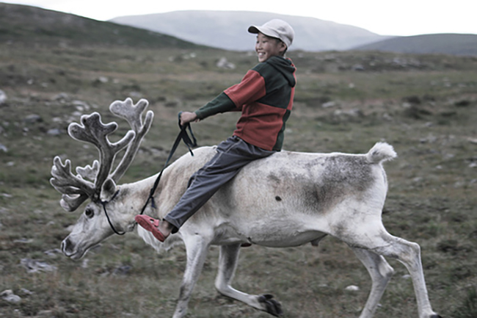
History
Invention of Wheel is major milestone in human history after fire

Slide 18
Horse
Carts

Slide 19
History
– 1869 Captain Nicholas
Cugnot
(French) build first Automobile
2.5mph (4.02 Kmph) in
15 minutes – 3 Wheeler
Steam
Piston's
Steering
1769 Cugnot Steamer in
HD.mp4
Steam
Generator
Rear Wheel / Axle
Front Wheel

Slide 20
1801 – Richard
Carriage
threvithrick – Firs Steam
TREVITHICK'S PUFFING DEVIL
ON TREVITHICK DAY 2017.mp4
Chimney
Trevithick was born in 1771
in a
mining
England.
village
He
in
was
Cornwall,
terrible
a
student–his
teachers
thought
he
was
a
“disobedient,
slow,
Steam
Generator
obstinate, [and] spoiled
boy” who
anything,
basically
would
never amount
to
and
in
fact
he was
e
illiterat
to tinker
h
is
e
entir
life–but he loved
Wheels
with tools and machines₆.
Puffing DEVIL

Slide 21
1885 – Benz
Motors in Germany developed
first
Vehicle
propelled
with
IC
Engine
videoplayback.mp4
7

Slide 22
…Contd
• 1897 – Mr. Foster from Crompton greaves,
borrowed first motor car in india
• 1901 -
INDIAN
Mr. Jamshed Ji TATA was the first
to
own
a
motor
car
.
Sir Jamshed Ji TATA

Slide 23
Classification
• Purpose
• Passenger Carriers – Car, Bus
• Goods Carriers - Trucks
• Fuel Used
• Petrol
• Diesel Gas
• Electric
• Steam – not in use
• Capacity
• HMV – Trucks, Buses
• LMV – Tempo, Jeeps
of
Automobiles
•
Construction
• Single unit
• Articulated – Eg. Trailers, Tractors
Drive
• Left hand
• Right Hand
Number of Wheels
• Two Wheeler
• Three Wheeler
• Four Wheeler
Body
• hatchback
• Sedan
• Convertibles
• Station Wagons - Vans
•
•
•
• Special Purpose Vehicles

Slide 25
Engine
SI – Spark Ignition
CI – Compression
Two Stroke
Ignition
Four
Stroke

Slide 26
Chassis & Other
important Parts
Vehicle BODY

Slide 27
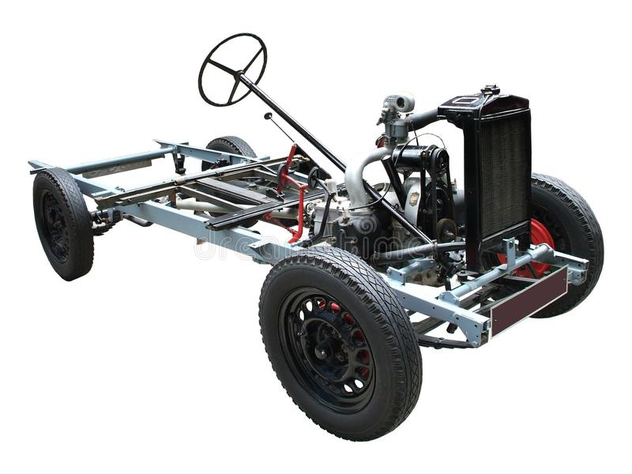
UNIT-I
Chassis

Slide 28
Chassis
Main Supporting Structure of vehicle consist of almost all major parts except automobile body

Slide 29
Key component of Chassis
Frame Have 3 different types
is
Frame
1.
2.
3.
Conventional frame
Integral Frame
Semi Integral Frame
Functions of Frame
• To support chassis components & body
• Withstand the static & dynamic load of different components of chassis
• To withstand load of the body
• To carry load
• To withstand stresses caused due to uneven road conditions.
• To withstand force caused due to turning of the vehicles &
sudden braking or acceleration.

Slide 30
15
REAR
FRONT

Slide 32
17

Slide 33
Frame
Cross
Sections
Channel Section – Good Resistance
to Bending
Box Section – Good Resistance to both bending
and torsion
Tubular Section – Good Resistance to torsion.

Slide 34
Types
of Chassis
• According to layout
• Conventional
• Forward
• Semi forward
• According to mounting of engine and transmission
• Engine at front
• Engine fitted in front but crosswise
• Engine fitted at the center of the chassis
• Engine fitted at the back

Slide 35
According
to
mounting
of
Component
of
Chassis
• Front Engine Rear Wheel Drive
• Front Engine Front Wheel Drive
• Rear Engine Rear Wheel Drive
• All Wheel Drive

Slide 36
Conventional Chassis
Affects visibility of driver
Engine is fitted in front of the driver cabin or driver seat such as in cars.
Chassis portion can not be utilized for carrying passengers and goods
Heavy Engine can be fitted, which can used to give more power

Slide 37
Semi
Forward
Chassis
• Half portion of the engine is in the driver cabin
half is outside the cabin such as in Tata trucks /
& and remaining
Tempos
• In this arrangement a part of the chassis is utilized for carrying
extra passengers

Slide 38
Forward
Chassis
• Complete engine is mounted inside the driver cabin, Driver seat
is just above the front wheel.
• More Boot Space Available as full utilization of chassis

Slide 39
Engine
Conventionally
at
front
•
the
engines
are
fitted
at front
&
drive
is
given to
“rear”
the
wheels
from the
•
•
Advantages
Enough space is available for luggage behind the rear seat
The weight of vehicles is well
balance
•
•
Increased
efficiency
of
cooling system
24

Slide 40
Engine fitted in front but crosswise
•
This
front
engine
layout
requires very small space to
fit the engine. Hence, most
compact cars use this layout
which has very small space to
accommodate the engine.
Design is more complicated
•
as
compared
to
the
longitudinally placed engine.
This is because it does not
leave
enough
space
for
accessories.

Slide 41
Engine
is
mounted
at
center
•
Mid-engine,
rear-wheel drive
format can
be considered the
original layout of automobiles.
Drive is given to the rear.
Equal Distribution of weight.
•
•
•
Largest drawback of mid-engine
cars is
space;
restricted rear passenger
•
Consequently most mid-engine
vehicles are two-seat vehicles.
The engine in effect pushes the
passenger compartment forward
towards the front axle (if engine is
behind driver).
•

Slide 42
Engine
Fitted
at
back
•
Flat floor is available since
long
propeller
shafts
are
eliminated
•
With
propeller
elimination
of
center
giving
shaft
the
of
gravity
lowered
stable driving
Better adhesion
•
on road
climbing
specially
hill
when

Slide 43
Other
important
chassis
types
• Tabular Space Frame
• Monocoque Frame
• Backbone Frame
28

Slide 44
Tubular
Frame
•
•
It is 3-dimensional design
Tubular space frame chassis employs dozens of circular section tube, positions in
different
directions
to
provide mechanical strength against force from anywhere.
•
These tubes are welded &
forms
a
very
complex
structure.
r
r
h
• Fo
ngt
required
highe
y
stre
b
sports
cars, tubular space
frame
chassis
usually
incorporate a strong structure under both doors.

Slide 45
Advantages
&
Dis
advantages
• Very
strong
in
any •
Very complex , costly
and time consuming to
be built.
It engages a lot of
spaces rise the door seal
and result in difficult to
access to the cabin.
direction
with ladder
Monocoque
(compared
chassis and
chassis
of
•
the
same
weight)
•
Impossible
for
robotized production.

Slide 46
Monocoque
Monocoque is a one-piece structure which defines overall shape of the car. while ladder, tabular & backbone provide only stress members.
Today 99% car produced in this planet are made of steel Monocoque chassis.
Chassis are made by welding of Several pieces. (Spot Welding )
Monocoque is made of steel
31

Slide 47
Advantages
&
Disadvantages
• Space-efficiency.
• Monocoque
•
chassis •
It is very heavy.
Impossible for small
volume production.
In case of accidents
benefit crash production
because it uses
metal.
a
lot of
•
whole structure
obsolete.
become
• Cheap
production
for
mass

Slide 48
Back
• Similar
design.
Bone
Frame
to the body frame
• It consist
backbone
of a strong tubular
(Usually
rectangular in C/s).
• A body is placed on the structure.
• This type of chassis has been
used in numerous sports cars.

Slide 49
Advantages
&
Disadvantages
•
The vulnerable parts of the
drive shaft are covered by a
•
Manufacturing
backbone chassis
comp
the
more
is
thick
tube.
The
whole
licated an
.
d m
,
ore
e
system is extremely reliable.
costly
How
eve
r
ll
th m
-
ore
However,
if
a
problem
axles
with
wheel
drive
occurs, repairs are more
complicated.
are ne
eded,
t
he co
st
benefit tur
ns in f
e
avor
of
sis
•
The modular system enables
configurations of 2-, 3-, 4-,
5-, 6-, or 8-axle vehicles
backbon chas
.
•
The backbone
chassis
is
heavier for a given torsional
stiffness than a uni-body.
with various wheel
bases.
✓The
chassis
gives
no
side
protection
impacts.
against
34

Slide 50
Types
of
Vehicle
Layout
Or
Chassis
Layout
35

Slide 51
Front
Engine
Rear
Wheel
Drive
Engine
Transmission
Drive Shaft
Clutch
Final Drive

Slide 52
Front
Drive
Engine
Rear
Wheel
• Most common type of layout.
• Engine Located at front and driving power is given
to rear wheels.
• Driving Power
flows from engine to rear wheel
through
various
mechanical
linkages.

Slide 53
Advantages
&
Disadvantages
• Better handling : - Accelerating force is applied to
the rear wheels, on which the down
due to load transfer in acceler
force
increases,
ation, making the rear
ltaneous acceleration es.
tires better able to take simu
and
curving
than
the
front
tir
ON DRY ROAD ONLY

Slide 54
Even
weight
distribution
• The division of weight between the front and rear
wheels has a significant impact on a
car's handling,
and
it
is
much
easier
to
get
a
50/50
weight
distribution in a rear wheel drive car.
Steering radius
• As no complicated drive shaft joints
are required at
the front wheels, it is possible to turn them further
than
would
be
possible
using
front
wheel
drive,
resulting in a smaller steering radius.

Slide 55
Less
load
at front
axle
• The driving force is given at rear axle hence there is
no
need
to
provide
complex
design
on
front
axle.
Effective Cooling of the engine due
to
exposure of cooling system to flowing air

Slide 56
Disadvantages
Decreased interior space – This isn't an issue in a vehicle with a ladder frame like a pickup truck, where the space used by the drive line is unusable for passengers or cargo. But in a passenger car, rear wheel drive means: Less front leg room (the transmission tunnel takes up a lot of space between the driver and front passenger), less leg room for center rear passengers (due to the tunnel needed for the drive shaft), and sometimes less trunk space (since there is also more hardware that must be placed underneath the trunk).

Slide 57
Less
Inner
space

Slide 58
Increased
weight
• The drive shaft, which connects the engine at the
front to the drive axle in the back, adds weight.
There is extra sheet metal to form the transmission
tunnel. A rear wheel drive car will weigh
slightly
more than a comparable front
wheel
drive
car,
but
less
than
four
wheel
drive.

Slide 59
Higher
purchase
price
• Due to the added cost of materials, rear wheel
drive
is
typically
slightly
more
expensive
to
purchase
vehicle.
.
than
a
comparable
front
wheel
drive

Slide 60
Front
Engine
Front
Wheel
Drive
Engine
Transmission
Final Drive

Slide 61
Front
Drive
Engine
Front
Wheel
•
In this type the engine is
mounted on the front side
of
the vehicle and
the
driving power is given to
the front wheels only.
The power flows from
engine to front axle.
This type of arrangement
•
•
have
additional
sub
type
cross
i.e.
front
mounted
engine.

Slide 62
Advantages
• Interior space:
• Since the powertrain
engine compartment
is a single unit contained in the
of the vehicle, there is no need
to
devote
interior
space
for
a driveshaft
tunnel
or
for
rear differential, increasing
the volume
available
passengers
and
cargo.
Engine
Inner
SPACE

Slide 63
Better
handling
on
slippery
surface
• Slippery-surface traction: placing the mass of the
drivetrain
over
the
driven
wheels
improves traction on wet, snowy, or icy surfaces.
Improved
drive
train
efficiency
• The
direct
connection
between
engine
and
transaxle reduce the mass and
of the drivetrain compared to
mechanical inertia
a rear-wheel drive
vehicle
with
a
similar
engine
and
transmission,
allowing greater fuel economy.

Slide 64
Disadvantages
• Less Turning Radius
• The drive shafts may limit the amount by which the
front wheels can turn, they are generally unable to
make the.
• More Weight on front results in rapid wear of
front tires.
• Front-wheel drive has worse acceleration than rear-wheel drive, which is why most sporty and race cars use rear-wheel drive.

Slide 65
Steering
AWD
FWD
VS
RWD
VS

Slide 66
FWD
VS
RWD

Slide 67
Rear
Engine
Rear
Wheel
Drive

Slide 68
54

Slide 69
Advantages
• Weight over rear wheels, increased traction while
accelerating.
• Front axle construction is simplified.
• Absence of propeller shaft results in decrease of floor height.
• Engine components mounted at rear of rear axle
hence more space is available.

Slide 70
Disadvantages
• Separate cooling mechanism
is needed for
effective cooling
mounted at rear.
of
the
engine
as the
engine
is
• More load on rear side may result in overturning
(Over steer) of the vehicle.
• Longer linkages are required to operate clutch,
gears from driver.

Slide 71
All
wheel
Drive

Slide 72
AWD
or
4WD
4 wheels can be engaged only in difficult terrain.
In normal condition power is given to rear wheels only.
All wheels Always
engaged.
Safe and advantageous over 4WD

Slide 73
Advantages
• 4WD improves traction
in dangerous driving
conditions,
such
as
snow,
make
ice,
rocks,
and
other
scenarios that can
control
difficult.
By
engaging both sets of wheels, traction and control
improves.
• Additional weight contributes to better grip on the
road.
• 4WD is great for those who like off-roading.

Slide 74
Disadvantages
•
The main disadvantage of 4WD is added cost for
purchase, maintenance, and fuel. The extra equipment
(differentials, transfer case, etc.) adds complexity and
weight to the vehicle, increasing initial market value,
tire wear, and the cost of repairs and maintenance.
The added power and weight of 4WD and AWD systems require more fuel, making them less efficient than their 2WD counterparts.
Added weight improves traction and control, but it also increases the braking distance required to make a complete stop. Lighter vehicles can avoid collision easier than heavier vehicles.
•
•

