Slide 1
DESIGN OF SOCKET
&
SPIGOT COTTER JOINT
Shehzad Ahmed
Asst. Professor
Mechanical Department
Anjuman College of Engineering & Technology

Slide 2
Course Outcome Covered in this Topic
CO
Course Outcome No. | Description | Keyword | Level of Bloom’s Taxonomy
CO502T.2 | Students will be able to evaluate & design knuckle, cotter & Rivetted joints. | Design, Evaluate | Level 5 ( Evaluate) & Level 6 ( Create )

Slide 3
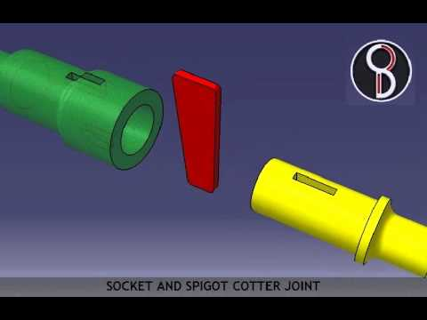
DESIGN OF SOCKET & SPIGOT COTTER JOINT

Slide 4
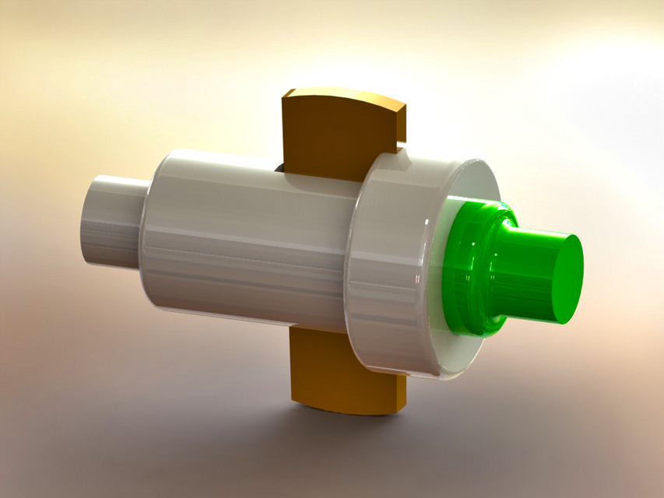

Slide 5
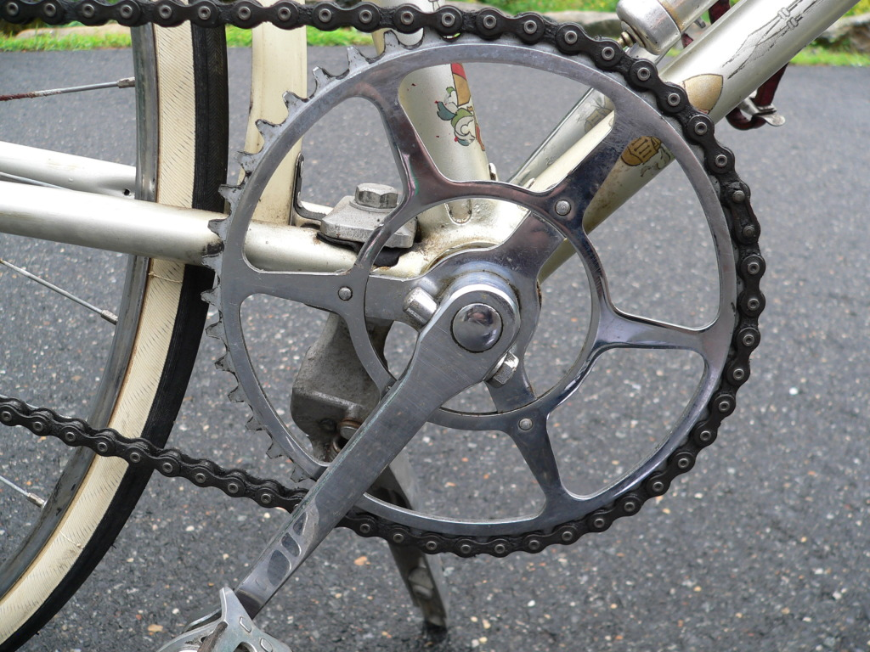
1. PEDAL & SPROCKET WHEEL

Slide 6
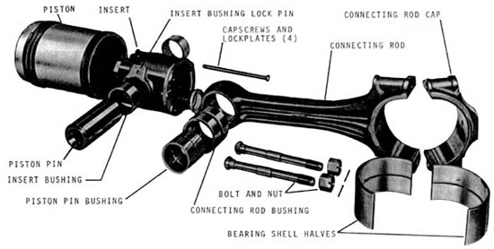
2. To Connect Piston Rod in Steam Engine

Slide 7
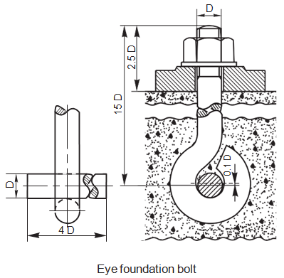
3. Foundation Bolt

Slide 8
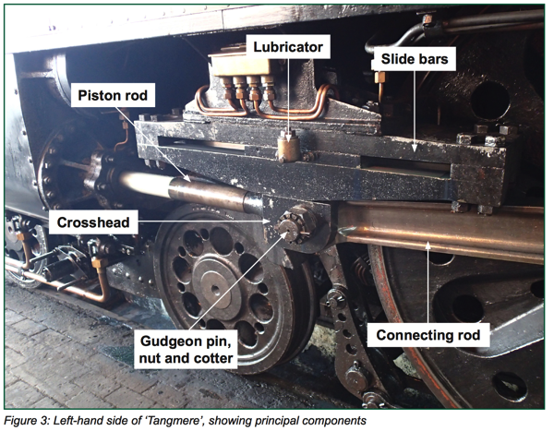
4. IN RAILWAY ENGINES

Slide 9
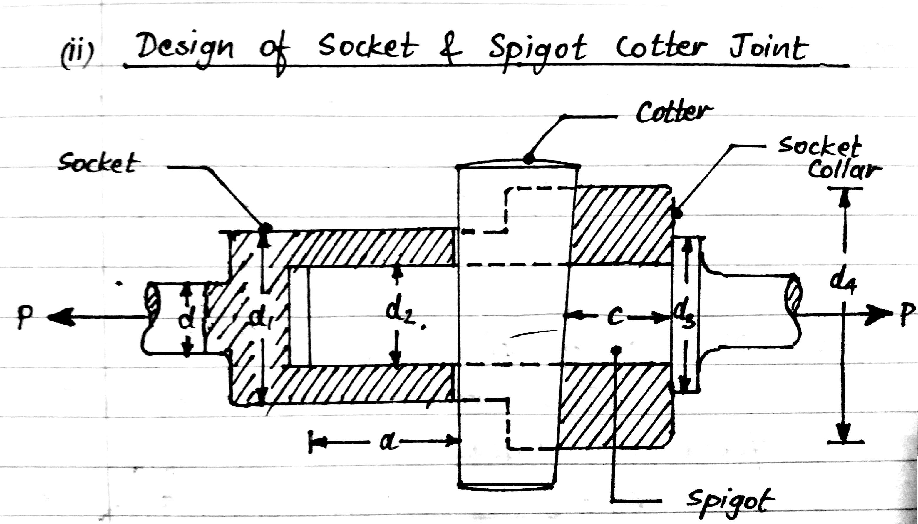

Slide 10
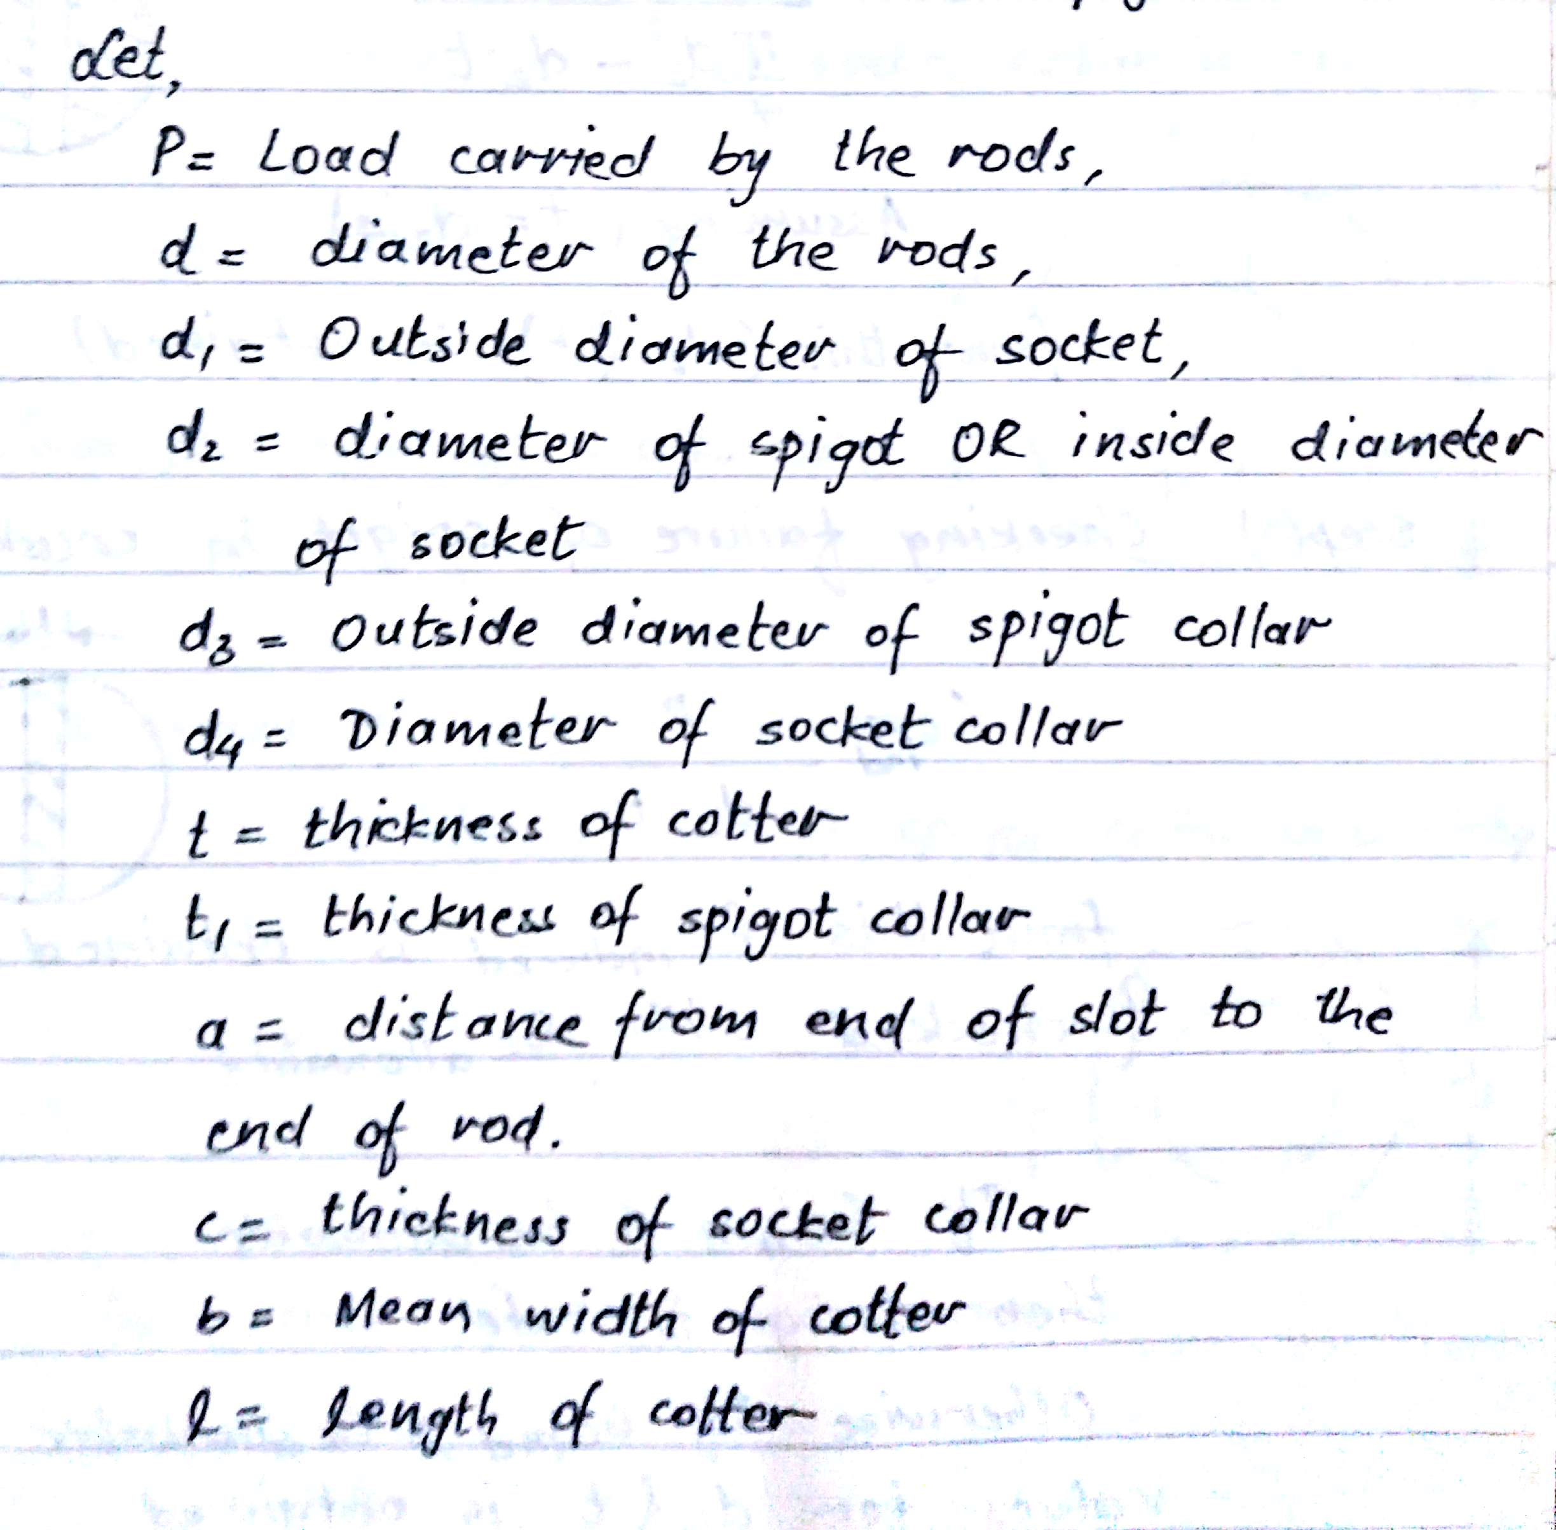

Slide 11
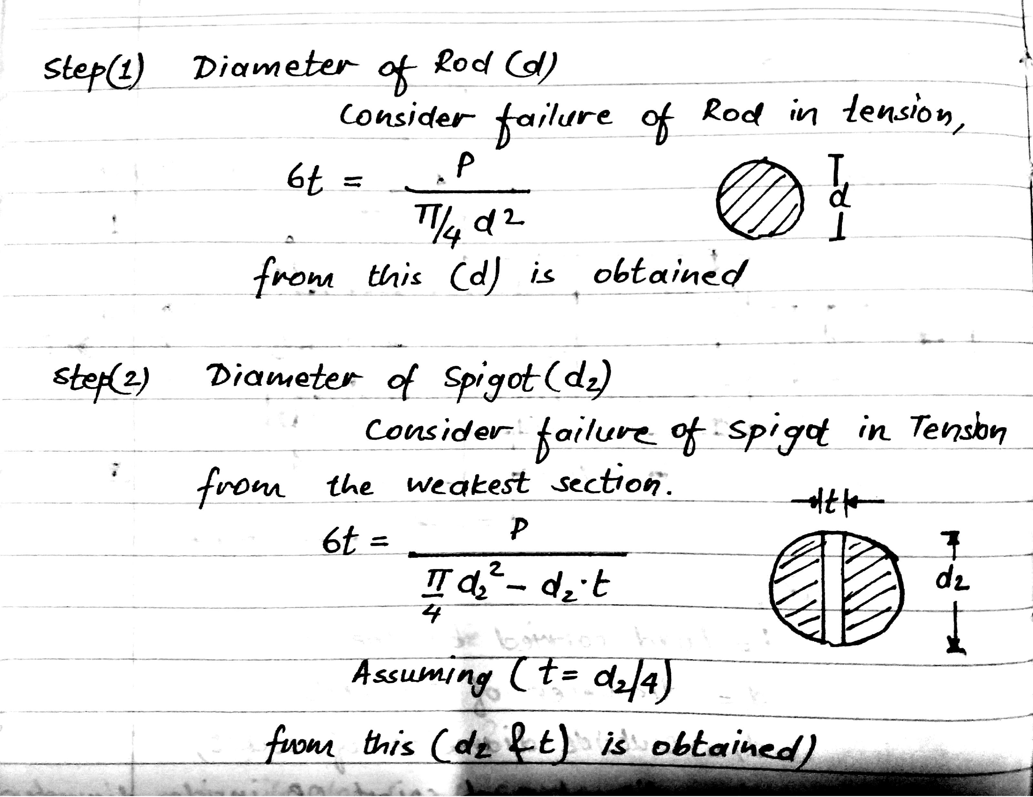

Slide 12
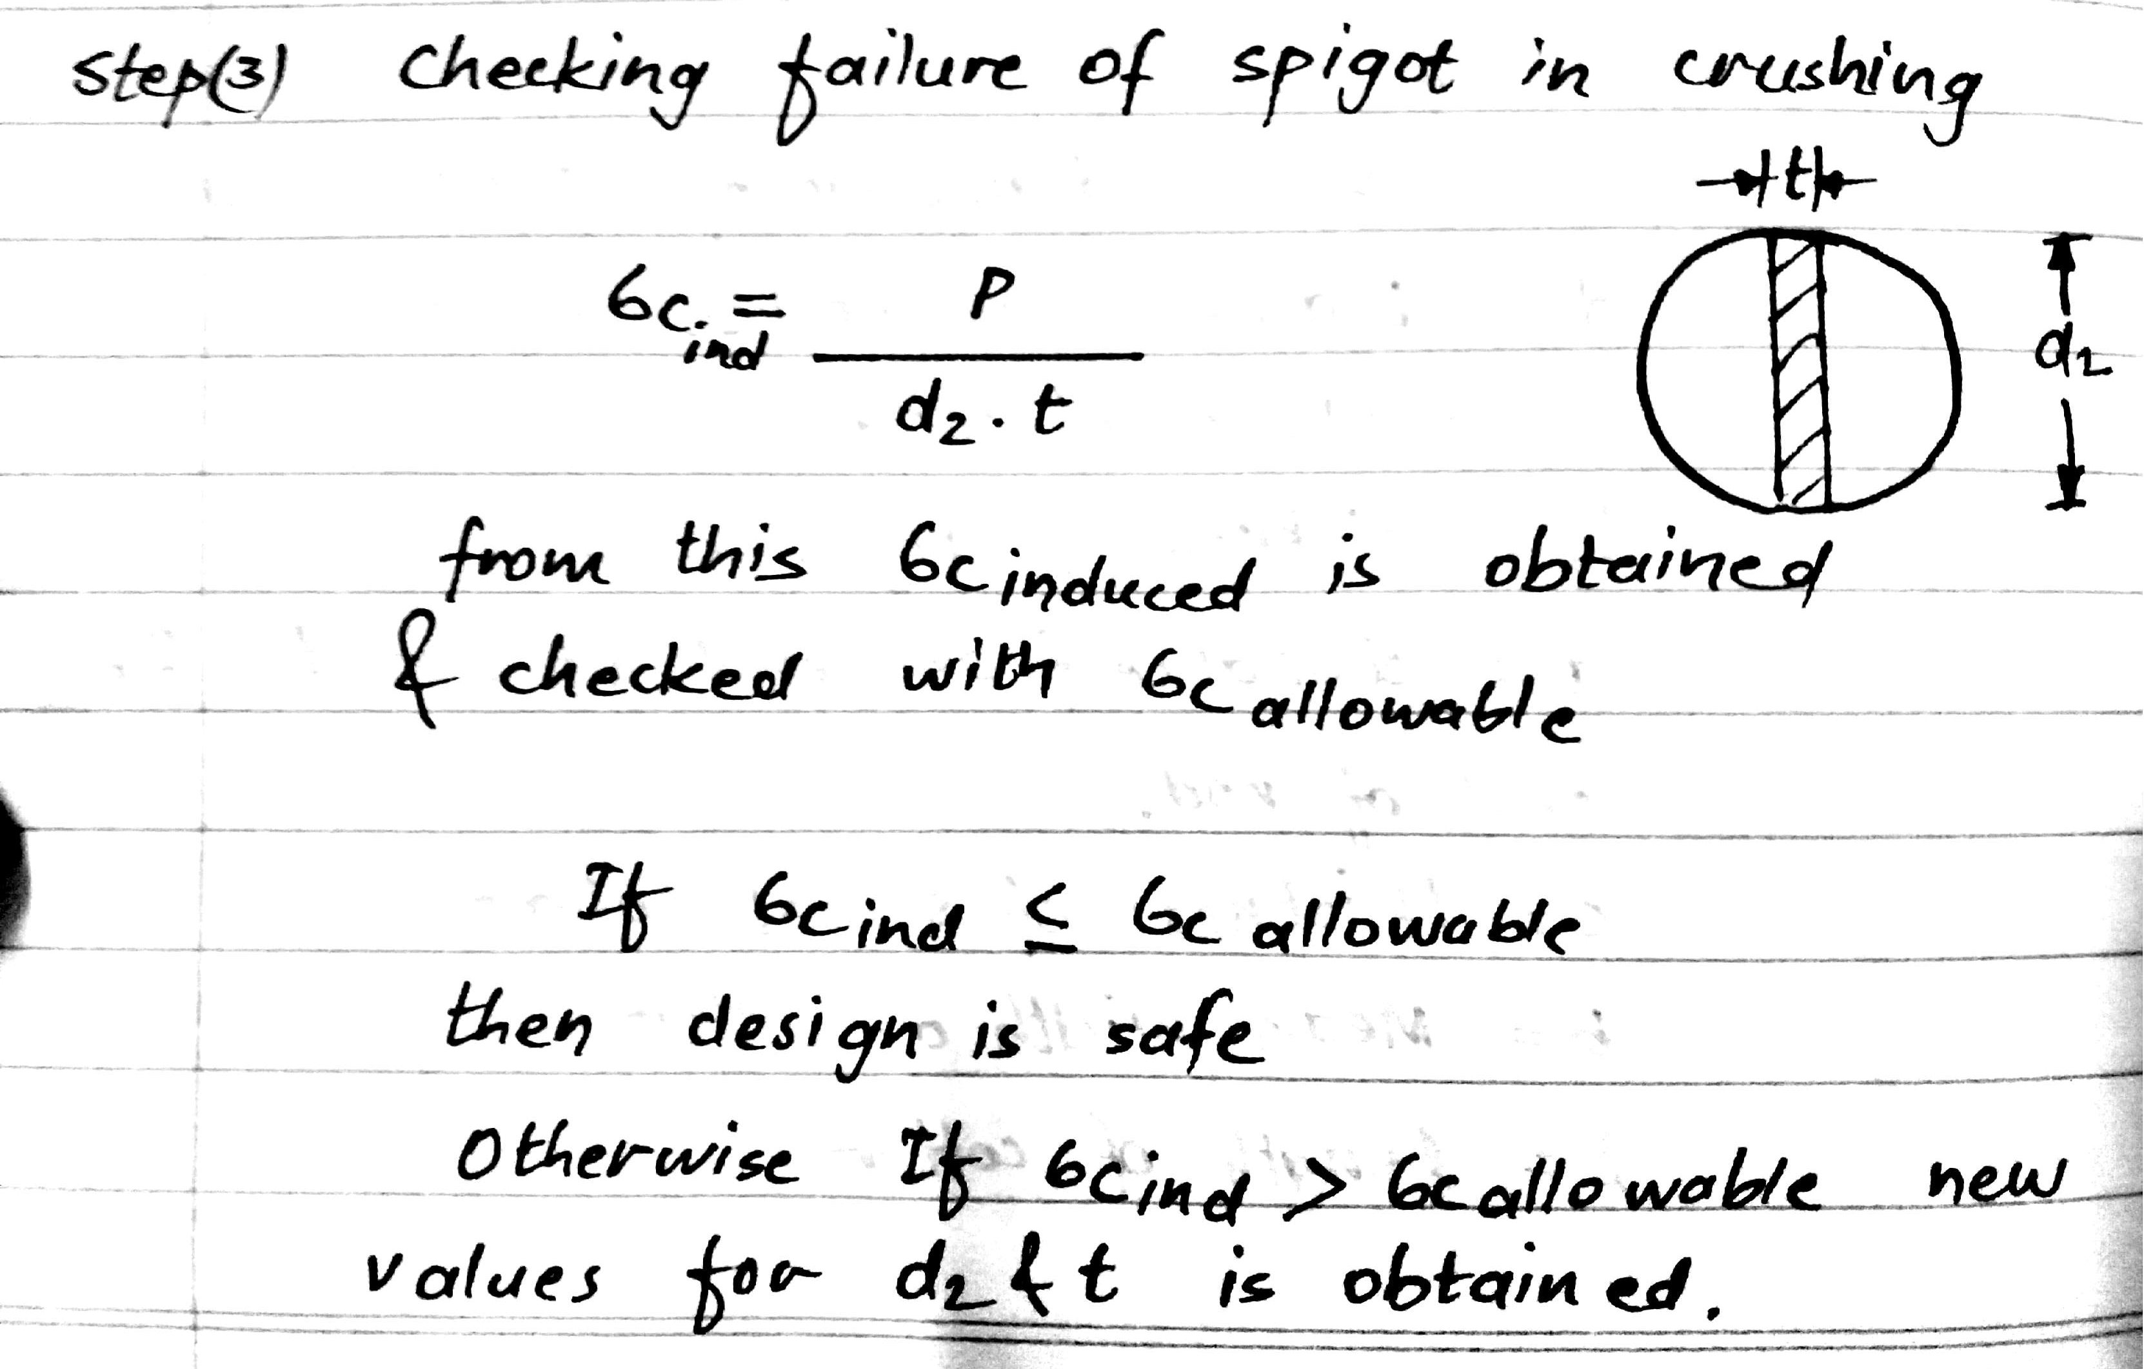

Slide 13
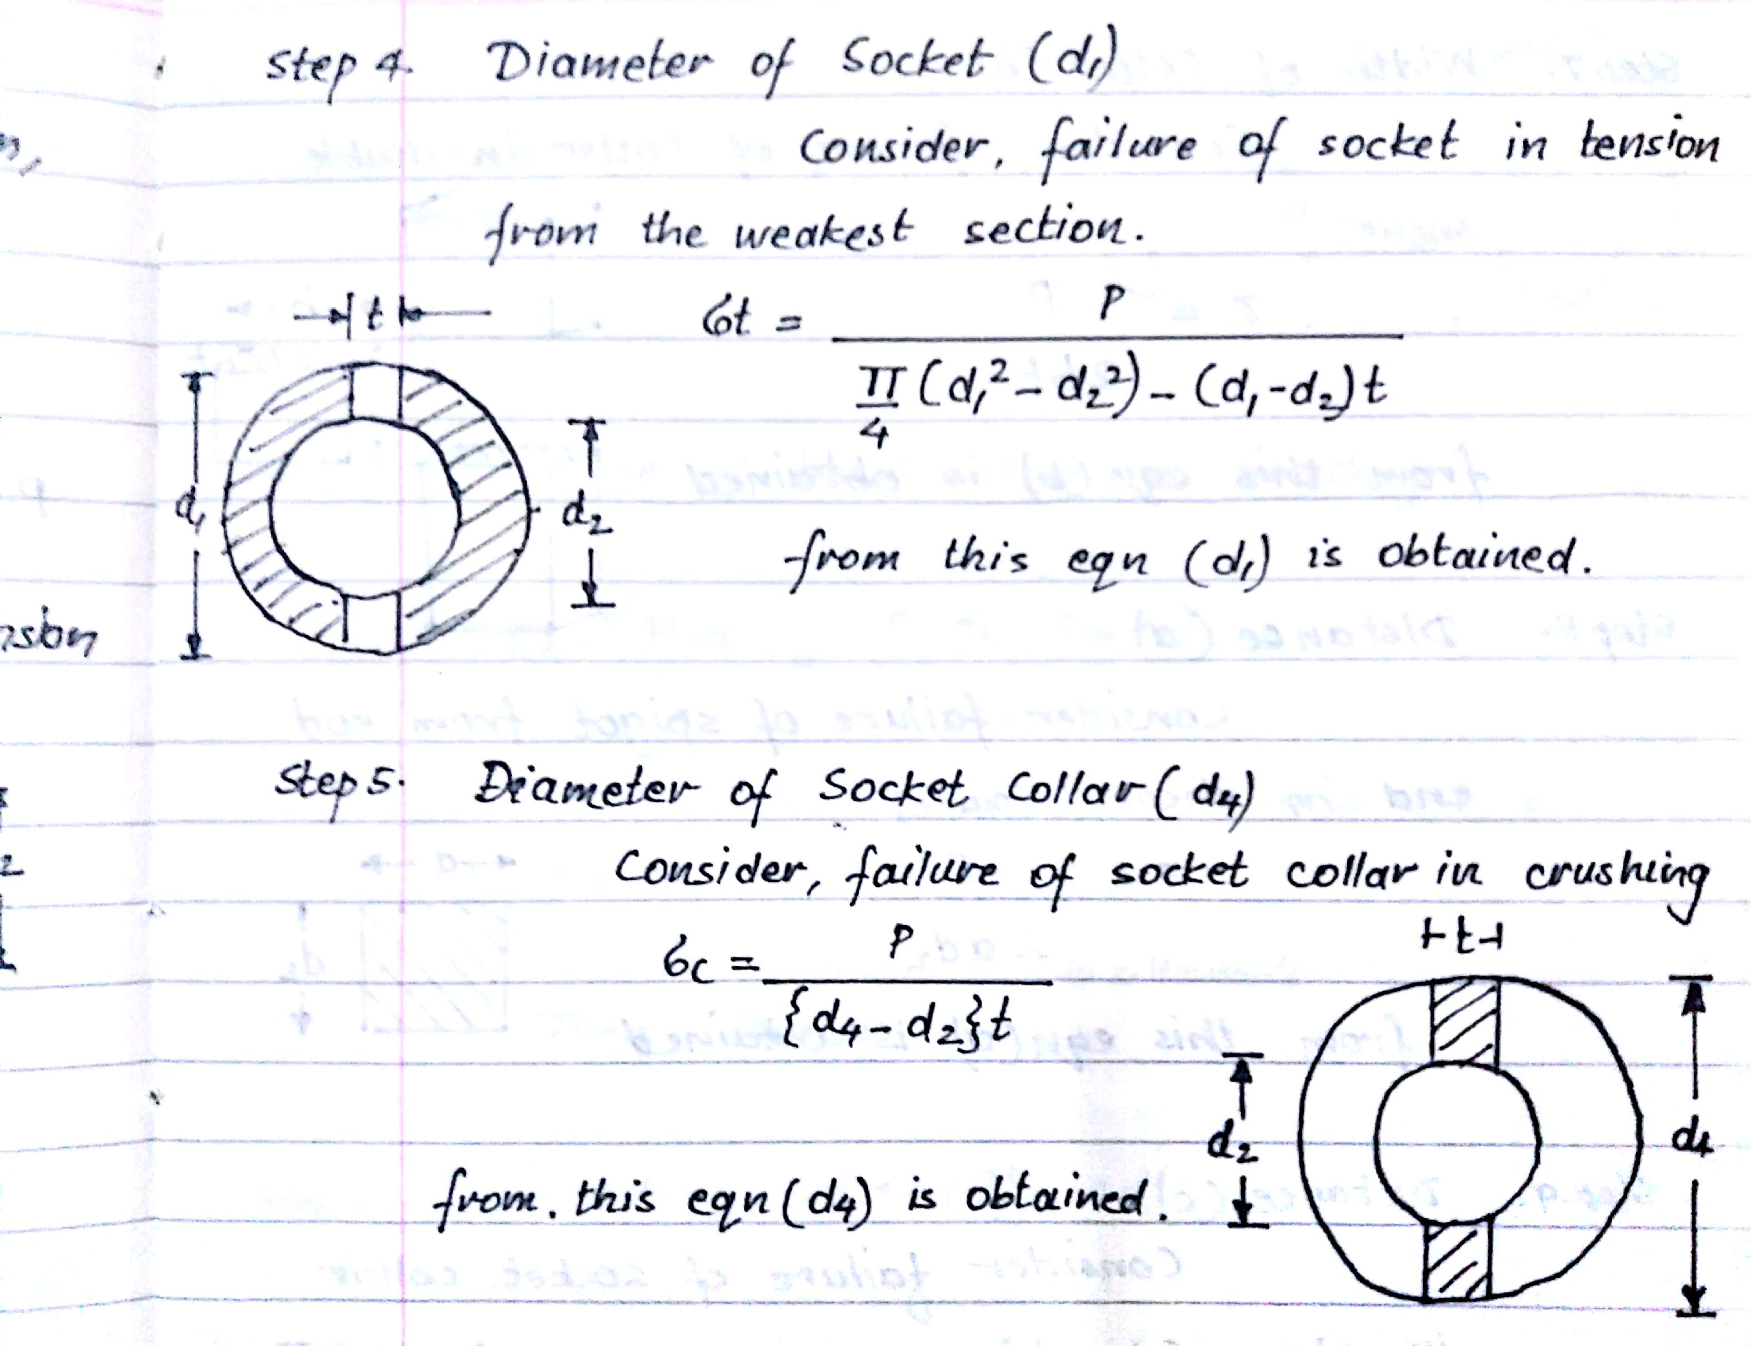

Slide 14
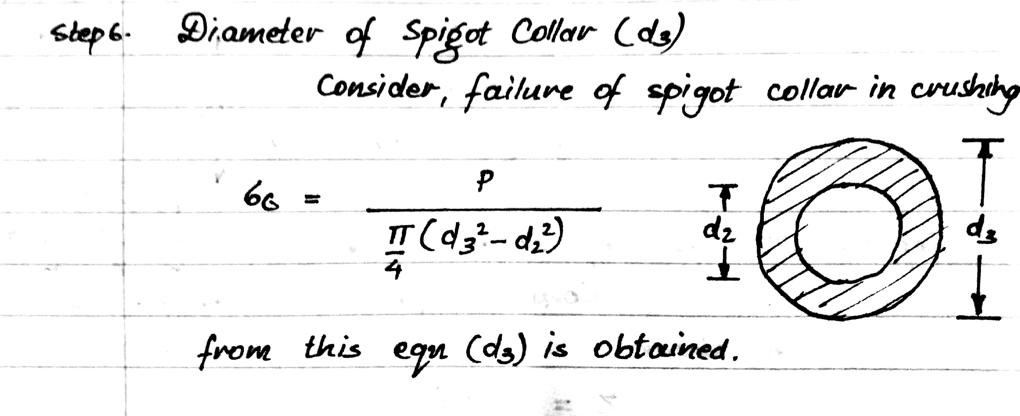

Slide 15
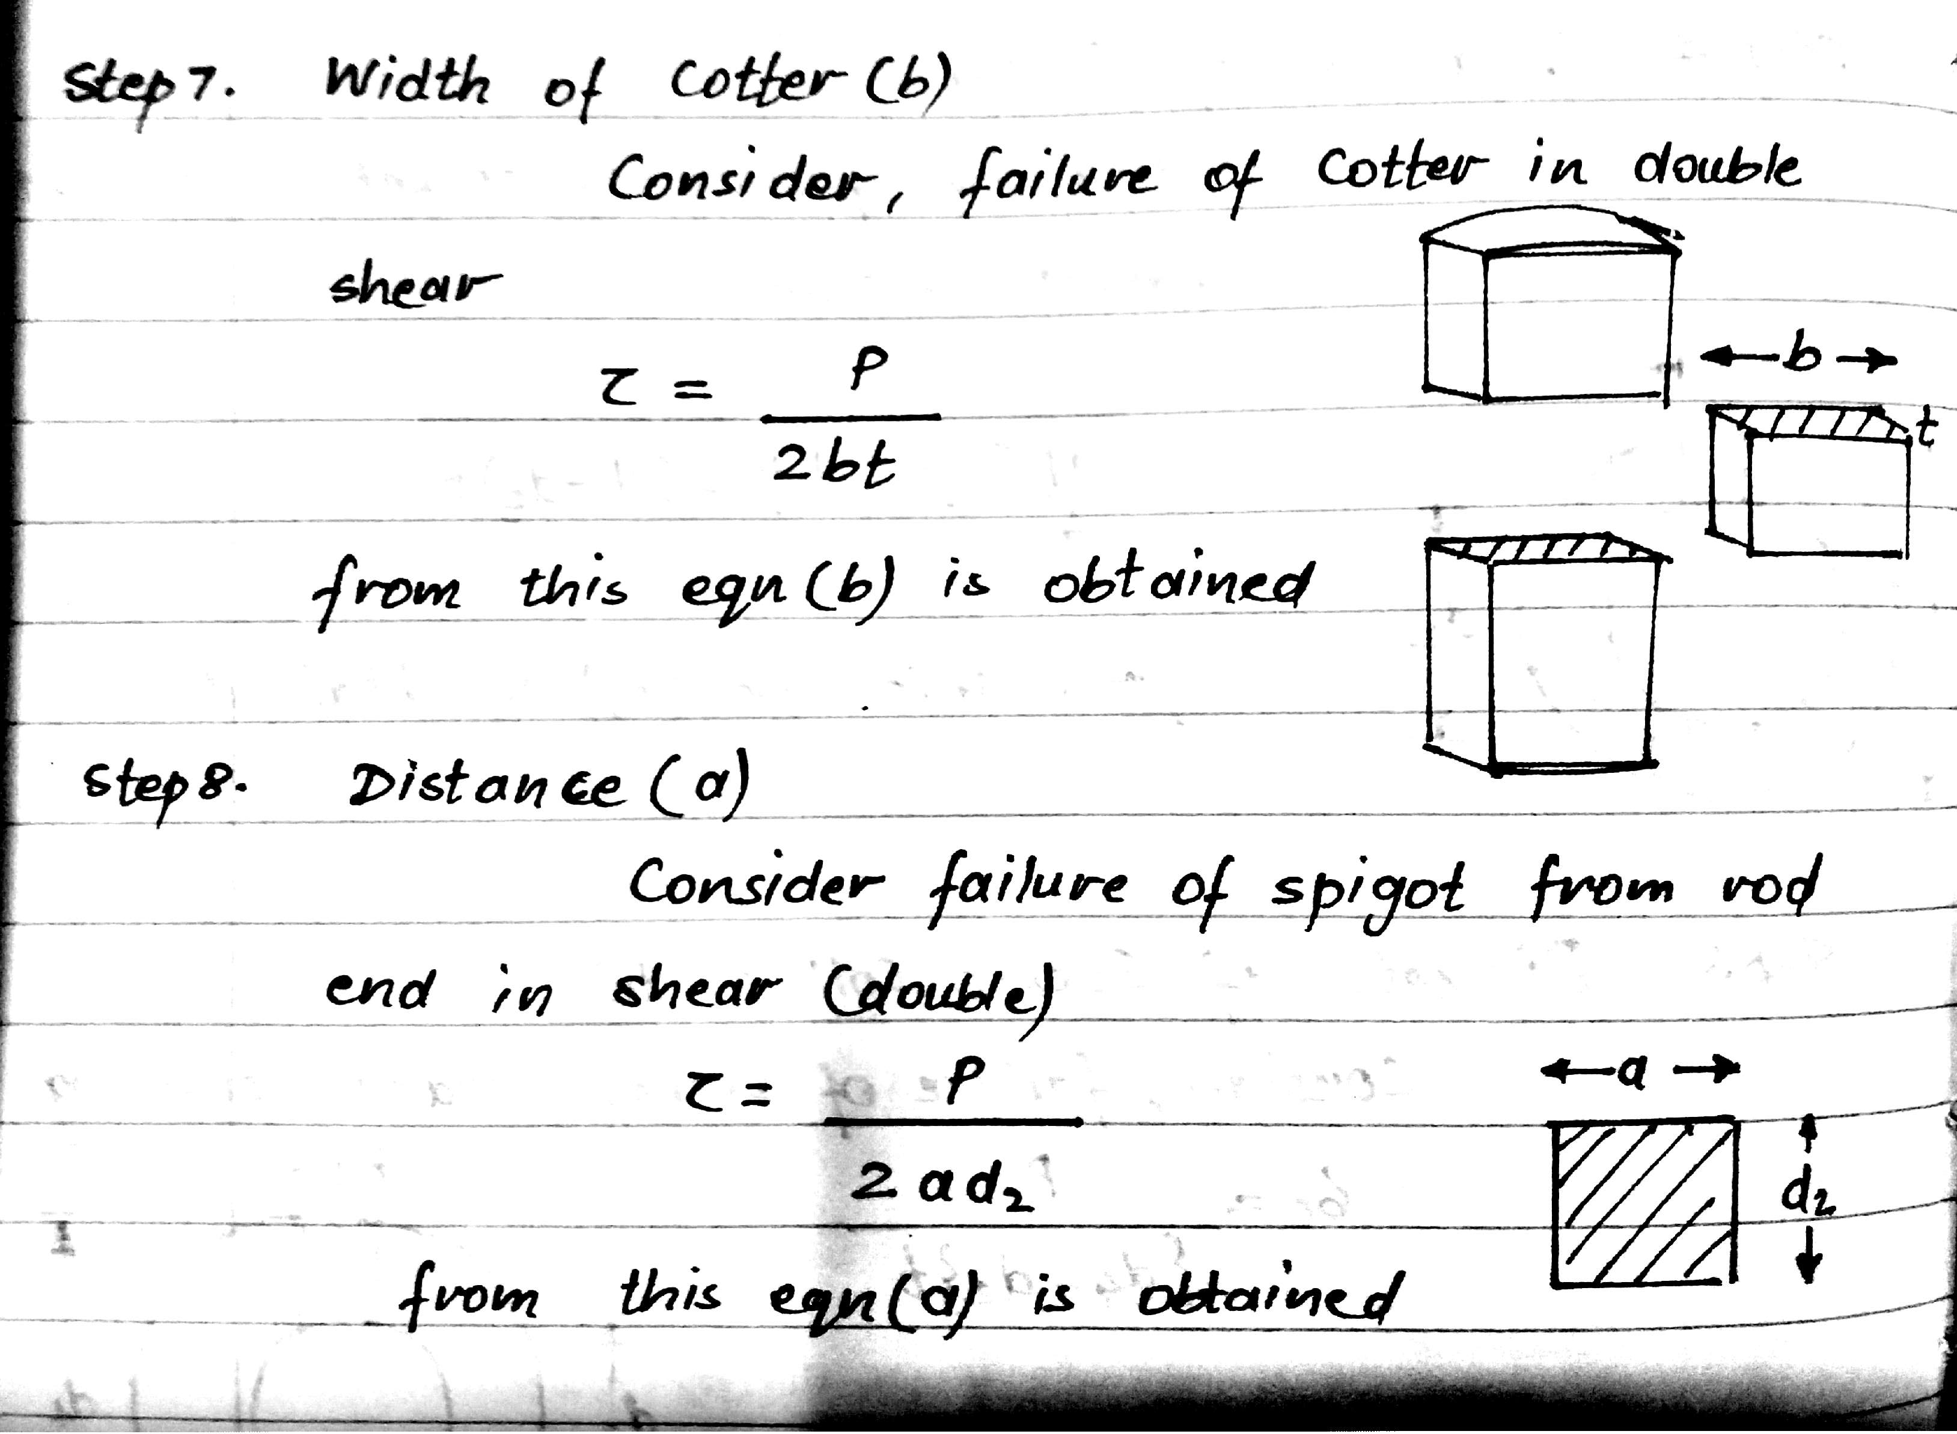

Slide 16
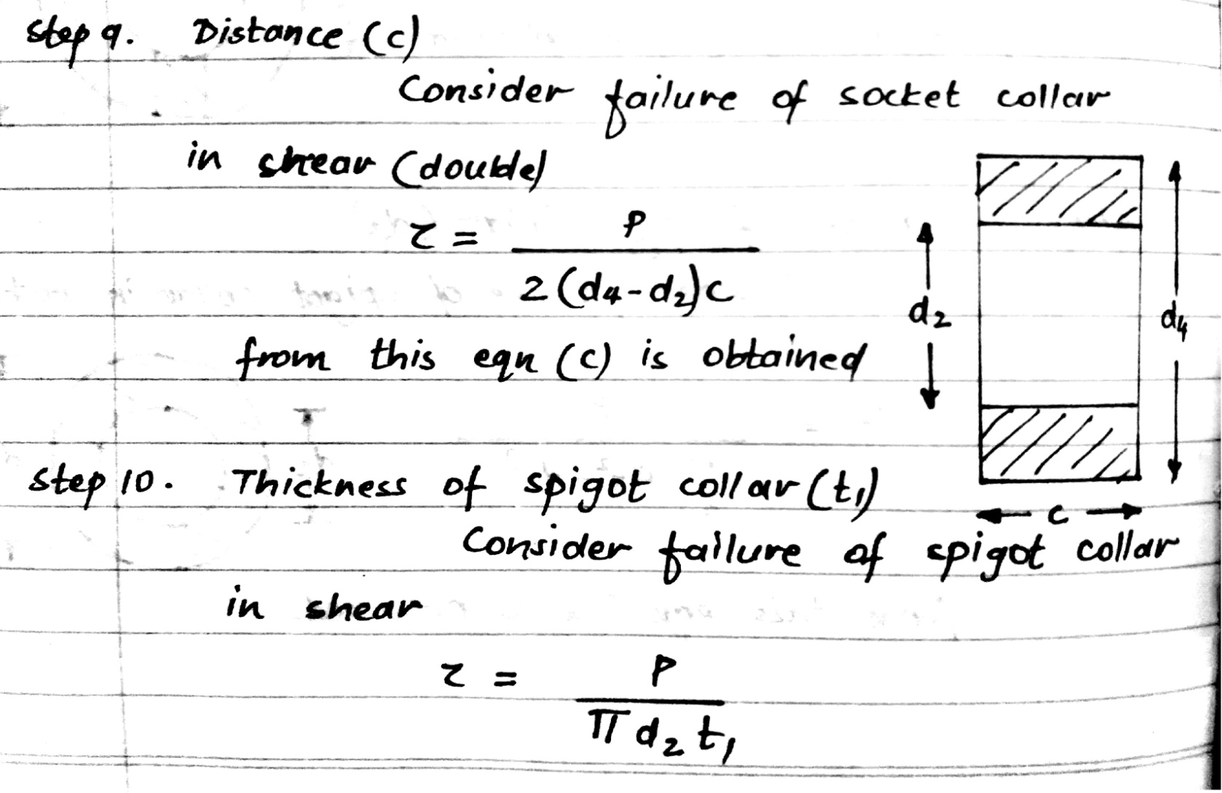

Slide 17
