Slide 1
Mechanics of Material
Simple Stresses & Strain

Slide 2
Stress:
when some external system of load acts on a body, the internal forces (equal & opposite) are set up at various section of the body, which resist the external force. This force per unit area at any section is known as stress.

Slide 3
Let us consider a rectangular bar of some cross–sectional area and subjected to some load or force (in Newton’s)
Let us imagine that the same rectangular bar is assumed to be cut into two halves at section X-X. The each portion of this rectangular bar is in equilibrium under the action of load P and the internal forces acting at the section X-X has been shown.

Slide 4
Now, stress is defined as the force intensity or force per unit area. Here we use a symbol to represent the stress
Where A is the area of the section X-X
The basic units of stress in S.I units i.e. (International system) are N / m2 (or Pa)
MPa = N /mm2 = 106 Pa, N /mm2 is equivalent to MPa
GPa = 103N /mm2 = 109N /m2= 109 Pa
KPa = 10-3N /mm2= 103 Pa.

Slide 5
TYPES OF STRESSES:
Only two basic stresses exist: (1) normal stress and (2) shear shear stress. Other stresses either are similar to these basic stresses or are a combination of this e.g. bending stress is a combination tensile, compressive and shear stresses. Torsional stress, as encountered in twisting of a shaft is a shearing stress.

Slide 8
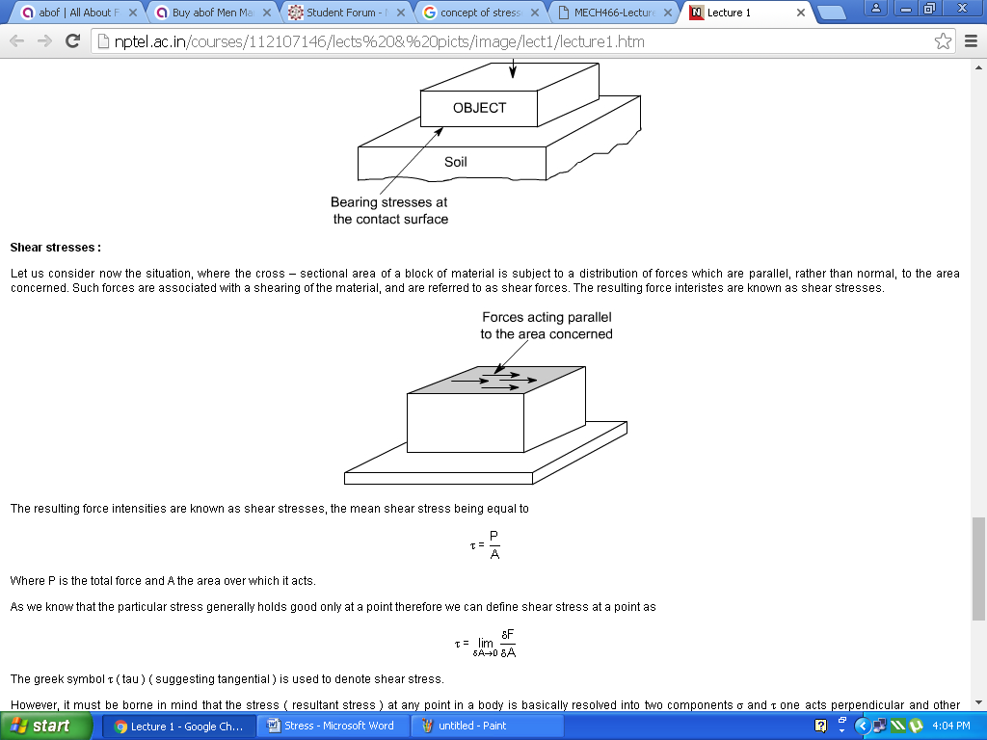
Bearing Stress: When one object presses against another, it is referred to a bearing stress (They are in fact the compressive stresses).
Here resulting force intensities are known as shear stresses, the mean shear stress being equal to
Where P is the total force and A the area over which it acts

Slide 10
Strain: Strain is the deformation of a material from stress. It is simply a ratio of the change in length to the original length. Deformations that are applied perpendicular to the cross section are normal strains.
Linear Strain: Linear strain of a deformed body is defined as the ratio of the change in length of the body due to the deformation to its original length in the direction of the force. If L is the original length and dL the change in length occurred due to the deformation, the linear strain e induced is given by ε=dL/L.
Linear strain may be a tensile strain, εt or a compressive strain εc according as dl refers to an increase in length or a decrease in length of the body. If we consider one of these as +ve then the other should be considered as –ve, as these are opposite in nature.
Lateral Strain: Lateral strain of a deformed body is defined as the ratio of the change in length (breadth of a rectangular bar or diameter of a circular bar) of the body due to the deformation to its original length (breadth of a rectangular bar or diameter of a circular bar) in the direction perpendicular to the force.

Slide 12
Volumetric Strain
Volumetric Strain is defined as the ratio of change in volume to the initial volume.

Slide 13
Shear Strain:
Shear strain is defined as the strain accompanying a shearing action. It is the angle in radian measure through which the body gets distorted when subjected to an external shearing action. It is denoted by ε
Consider a cube ABCD subjected to equal and opposite forces Q across the top and bottom forces AB and CD. If the bottom face is taken fixed, the cube gets distorted through angle Φ to the shape ABC’D’. Now strain or deformation per unit length is
Shear strain of cube = CC’ / CD = CC’ / BC = Φ radian

Slide 14
Hooks law
Hooks law: Hooke’s law stated that within elastic limit, The linear relationship between stress and strain for a bar in simple tension or compression is expressed by the equation, Stress  Strain, = Eε
In which is the axial stress, e is the axial strain, and E is a constant of proportionality known as the modulus of elasticity for the material. The modulus of elasticity is the slope of the stress-strain diagram in the linearly elastic region.
The equation = Eε is commonly known as Hooke’s law

Slide 15
Elastic Constants
Elastic Constants:
The elastic constants mostly used in engineering mechanics E, G and K can be defined as follows
Modulus of elasticity (Young's modulus) (E) describes tensile elasticity, or the tendency of an object to deform along an axis when opposing forces are applied along that axis; it is defined as the ratio of tensile stress to tensile strain. It is often referred to simply as the elastic modulus.

Slide 16
Modulus of Rigidity or Shear Modulus (G): is the coefficient of elasticity for a shearing or torsion force. Modulus of Rigidity is the coefficient of elasticity for a shearing force. It is defined as "the ratio of shear stress to the displacement per unit sample length”
Bulk modulus (K): When a body is subjected to like and equal direct stress along three mutually perpendicular directions, the ratio of this direct stress to corresponding volumetric strain is called Bulk modulus.
The Bulk Modulus Elasticity or Volume Modulus is a material property characterizing the compressibility of a fluid, how easy a unit volume of a fluid can be changed when changing the pressure working upon it. It describes the elastic properties of a solid or fluid when it is under pressure on all surfaces.

Slide 17
Factor of Safety (FoS) or safety factor (SF): is a term describing the load carrying capacity of a system beyond the expected or actual loads. Essentially, the factor of safety is how much stronger the system is than it usually needs to be for an intended load.
It is a multiplier applied to the calculated maximum stress to which a component will be subjected. Typically, for components whose failure could result in substantial financial loss, or serious injury or death, a safety factor of at least four (4) is used. Non-critical components generally have a safety factor of two (2). Safety factors are needed to account for imperfections in materials, flaws in assembly, material degradation, and unexpected stresses.

Slide 18
Properties of Materials
Some properties of materials which judge the strength of materials are given below:
Elasticity: It is the property by virtue of which a material deforms under the applied load and it is enabled to return to its original position when the load is removed.
Plasticity: It is the property of the material by which it undergoes inelastic strain beyond those at the elastic limit is known as the plasticity. It is also defined as unrecoverable strain.
Ductility: It is the property of the material by which it undergoes considerable amount of deformation without rupture. A ductile material must possess a high degree of plasticity and strength.
Brittleness: It is lack of ductility, a brittle material rupture with little or no plastic deformation.

Slide 19
Properties of Materials
Strength: This is the maximum stress that a material can take. This is equal to maximum load divided by area.
Hardness: It is the ability of material to resist against surface abrasion or indentation.
Toughness: It is the property of material which enables it to absorb energy without fracture. It is represented by area under stress-strain curve upto fracture.
Fatigue: Fatigue is the progressive and localized structural damage that occurs when a material is subjected to cyclic loading or repeated loading and unloading.

